Slide 1
How To: Watch an isolate not in a cluster
NCBI Pathogen Detection https://www.ncbi.nlm.nih.gov/pathogens

Slide 2
At a glance
You need to be logged into NCBI to save searches
Use the isolates browser https://www.ncbi.nlm.nih.gov/pathogens/isolates/
Search for your isolate “AND erd_group:*” so that the system will send an email if any other isolate appears in the same SNP cluster as this one

Slide 3
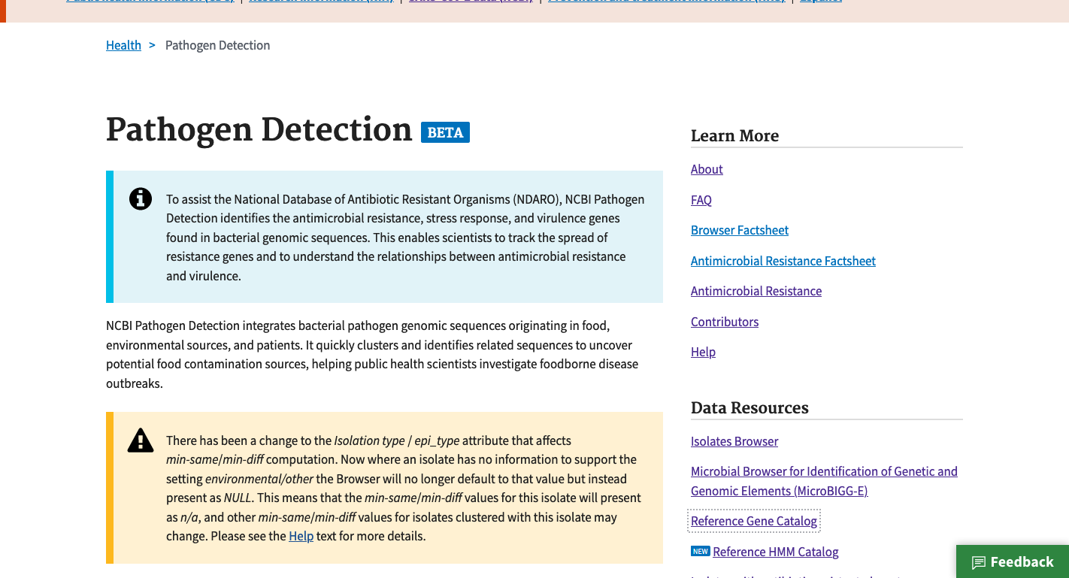
https://www.ncbi.nlm.nih.gov/pathogens
1. Click Isolates Browser

Slide 4
https://www.ncbi.nlm.nih.gov/pathogens/isolates
2. Log into your account if you’re not already logged in

Slide 5
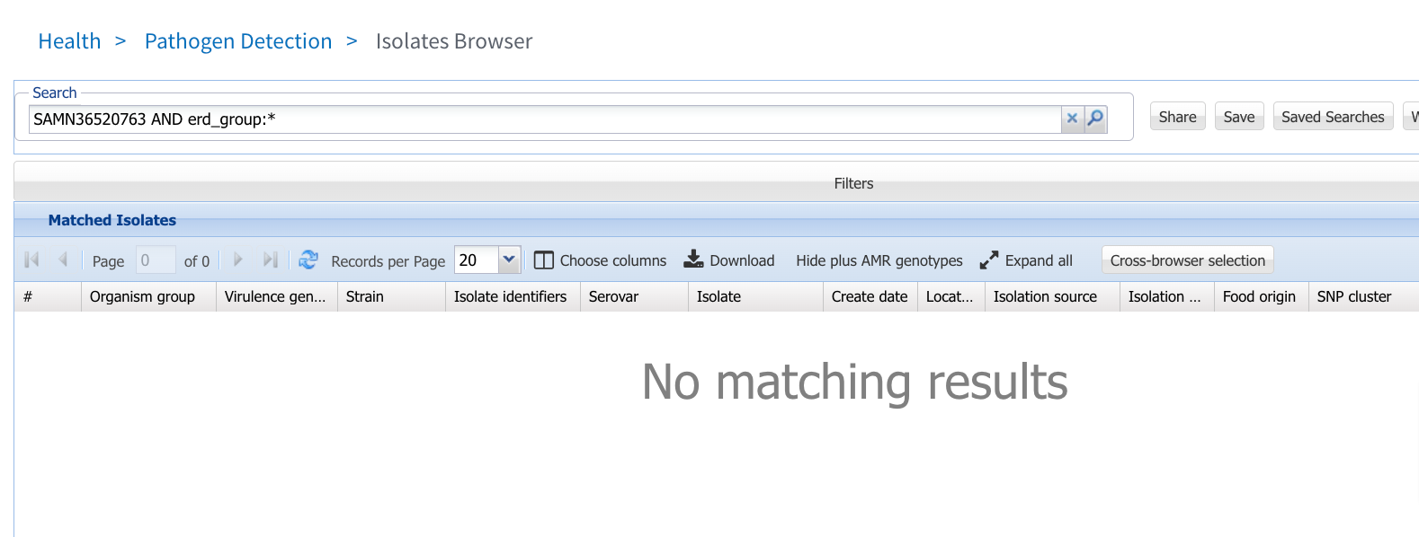
https://www.ncbi.nlm.nih.gov/pathogens/isolates
3. Search for your isolate “AND erd_group:*”
Note ”AND” must be in all capitals
4. Click Save to save this search

Slide 6
https://www.ncbi.nlm.nih.gov/pathogens/isolates
5. Give your search a name
6. Click Save to save your search and have the system email you when there are new results.

Slide 7
More information
For full help documentation of the Isolates Browser: https://www.ncbi.nlm.nih.gov/pathogens/pathogens_help/#isolates-browser
For details about saved searches see: https://www.ncbi.nlm.nih.gov/pathogens/pathogens_help/#automated-searches-save
Questions and further help: email pd-help@ncbi.nlm.nih.gov

