Slide 1
How To: Find the latest Salmonella in the Isolates Browser
NCBI Pathogen Detection https://www.ncbi.nlm.nih.gov/pathogens

Slide 2
How do I find the latest Salmonella in the Isolates Browser?
Method 1:
  Select “New Isolates” for Salmonella enterica on the Pathogen Detection home page
  Download table
Method 2:
  Use the “new:1” syntax in the Isolates Browser search window
  Use filters or search to select Organism Group “Salmonella enterica ”
  Download table

Slide 3
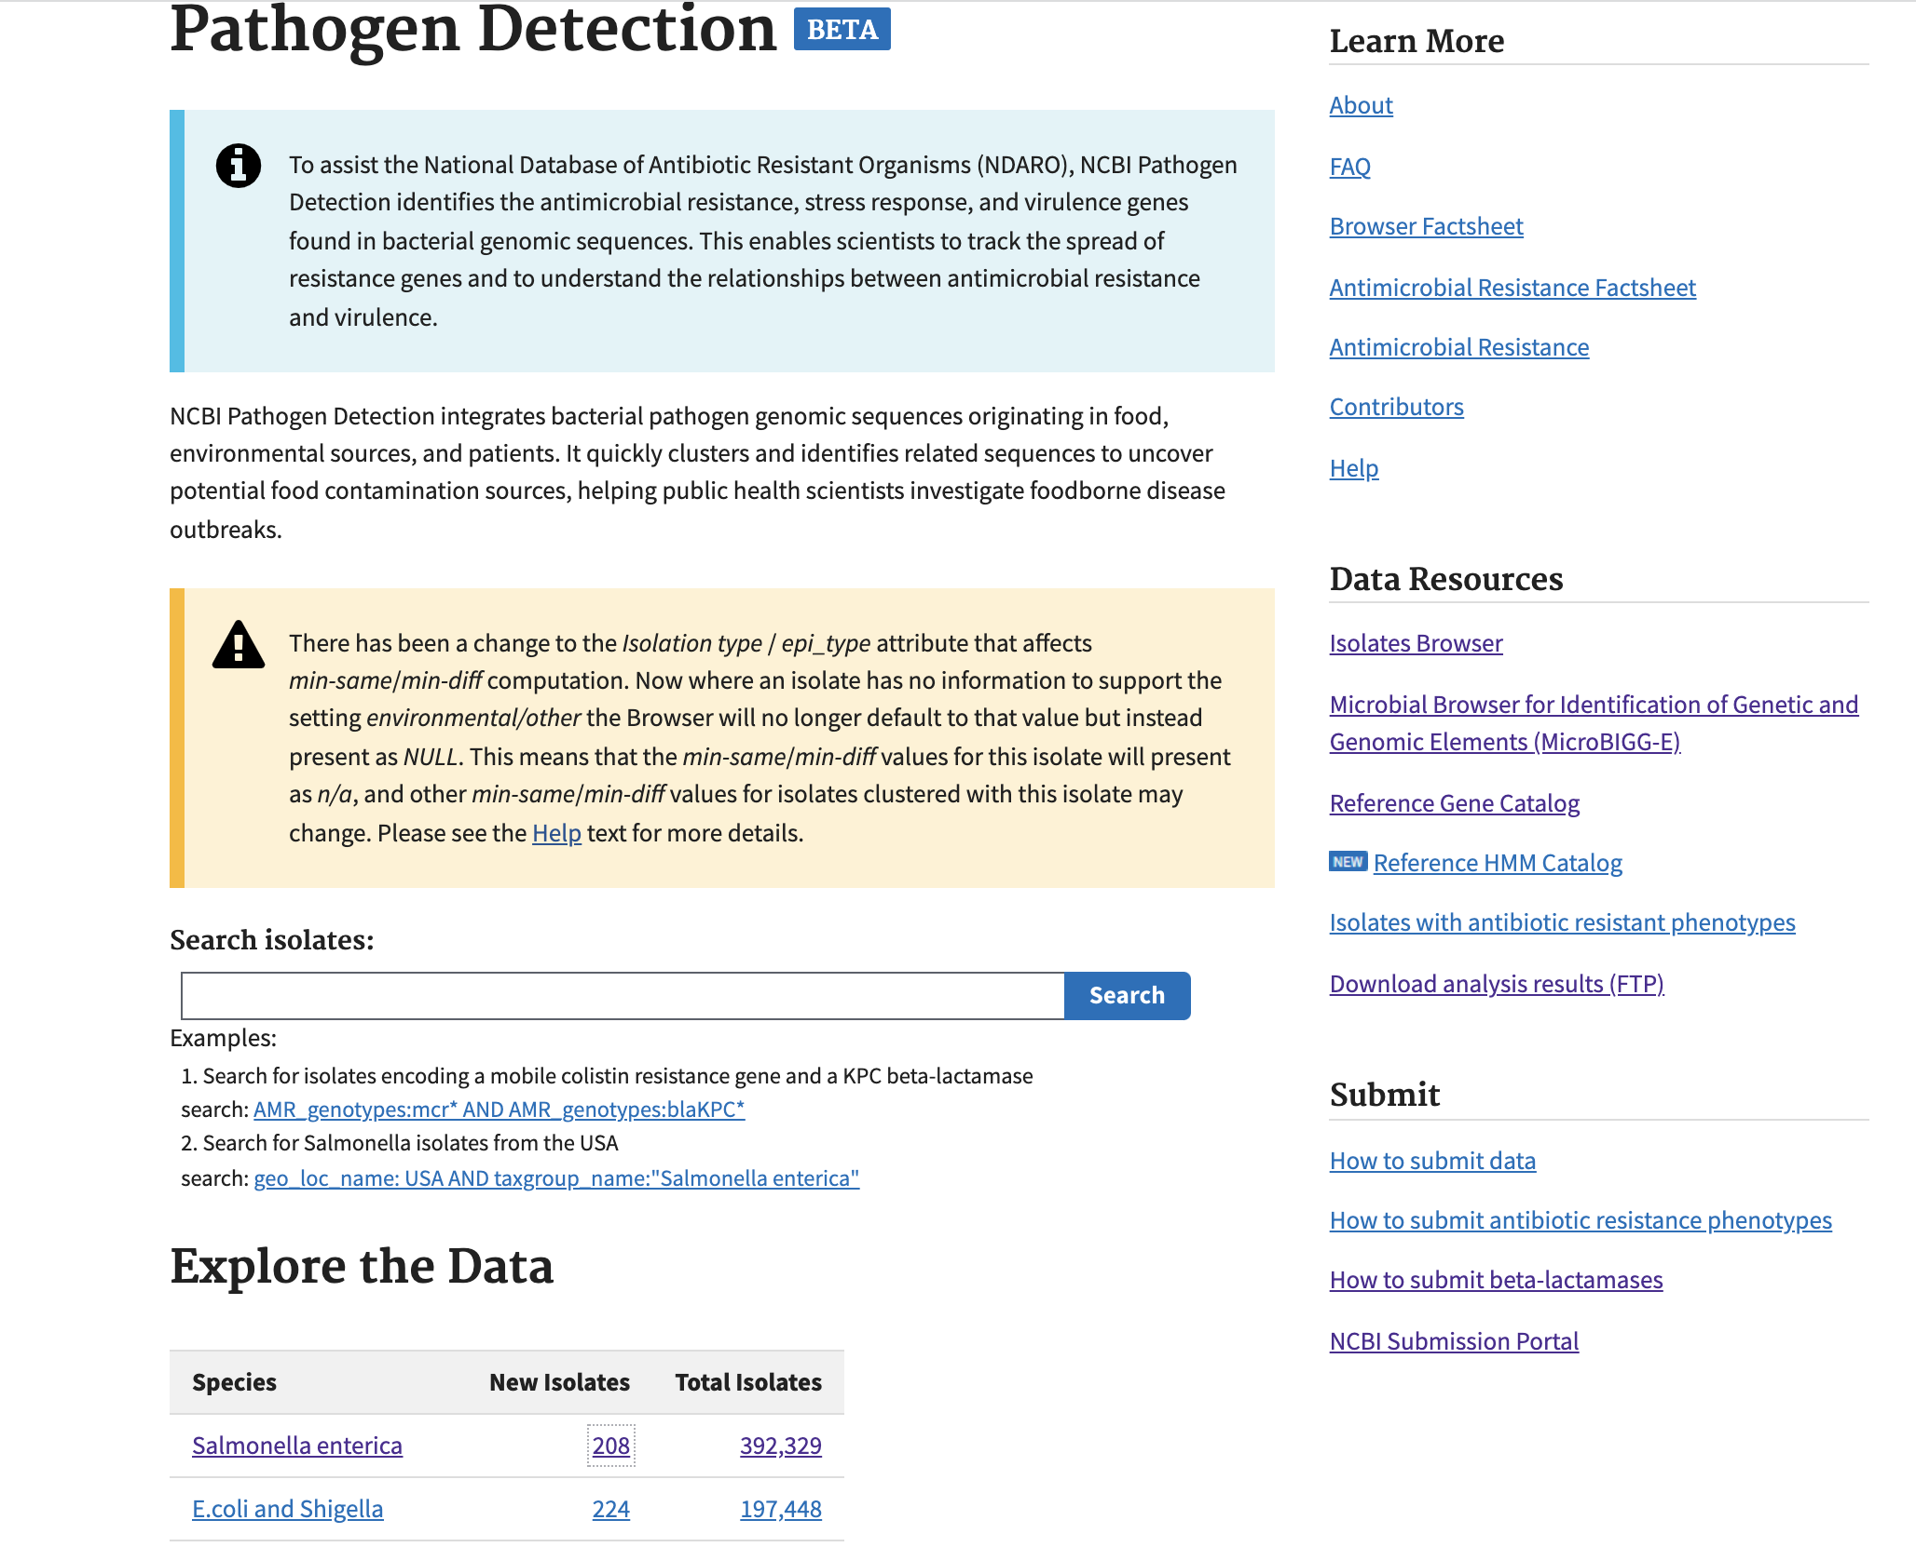
1. Click “208” in the New Isolates column

Slide 4
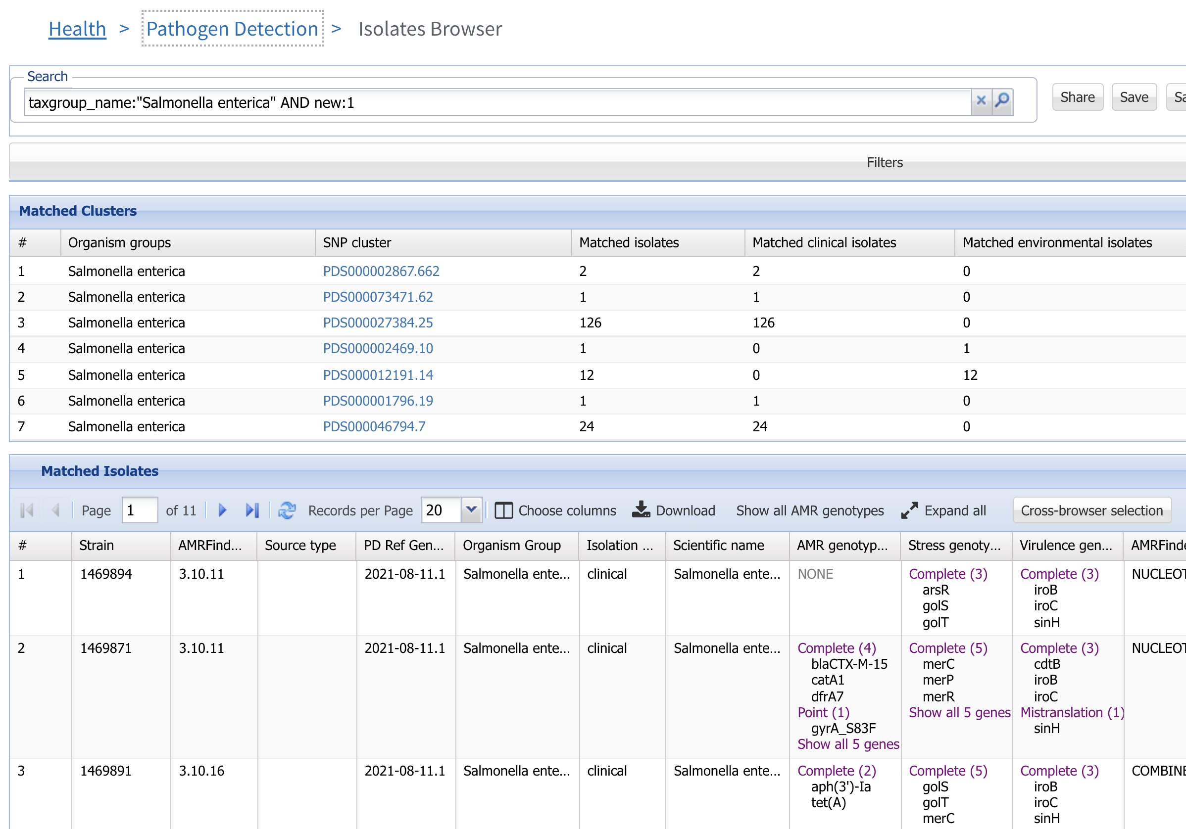
2. Click Download

Slide 5
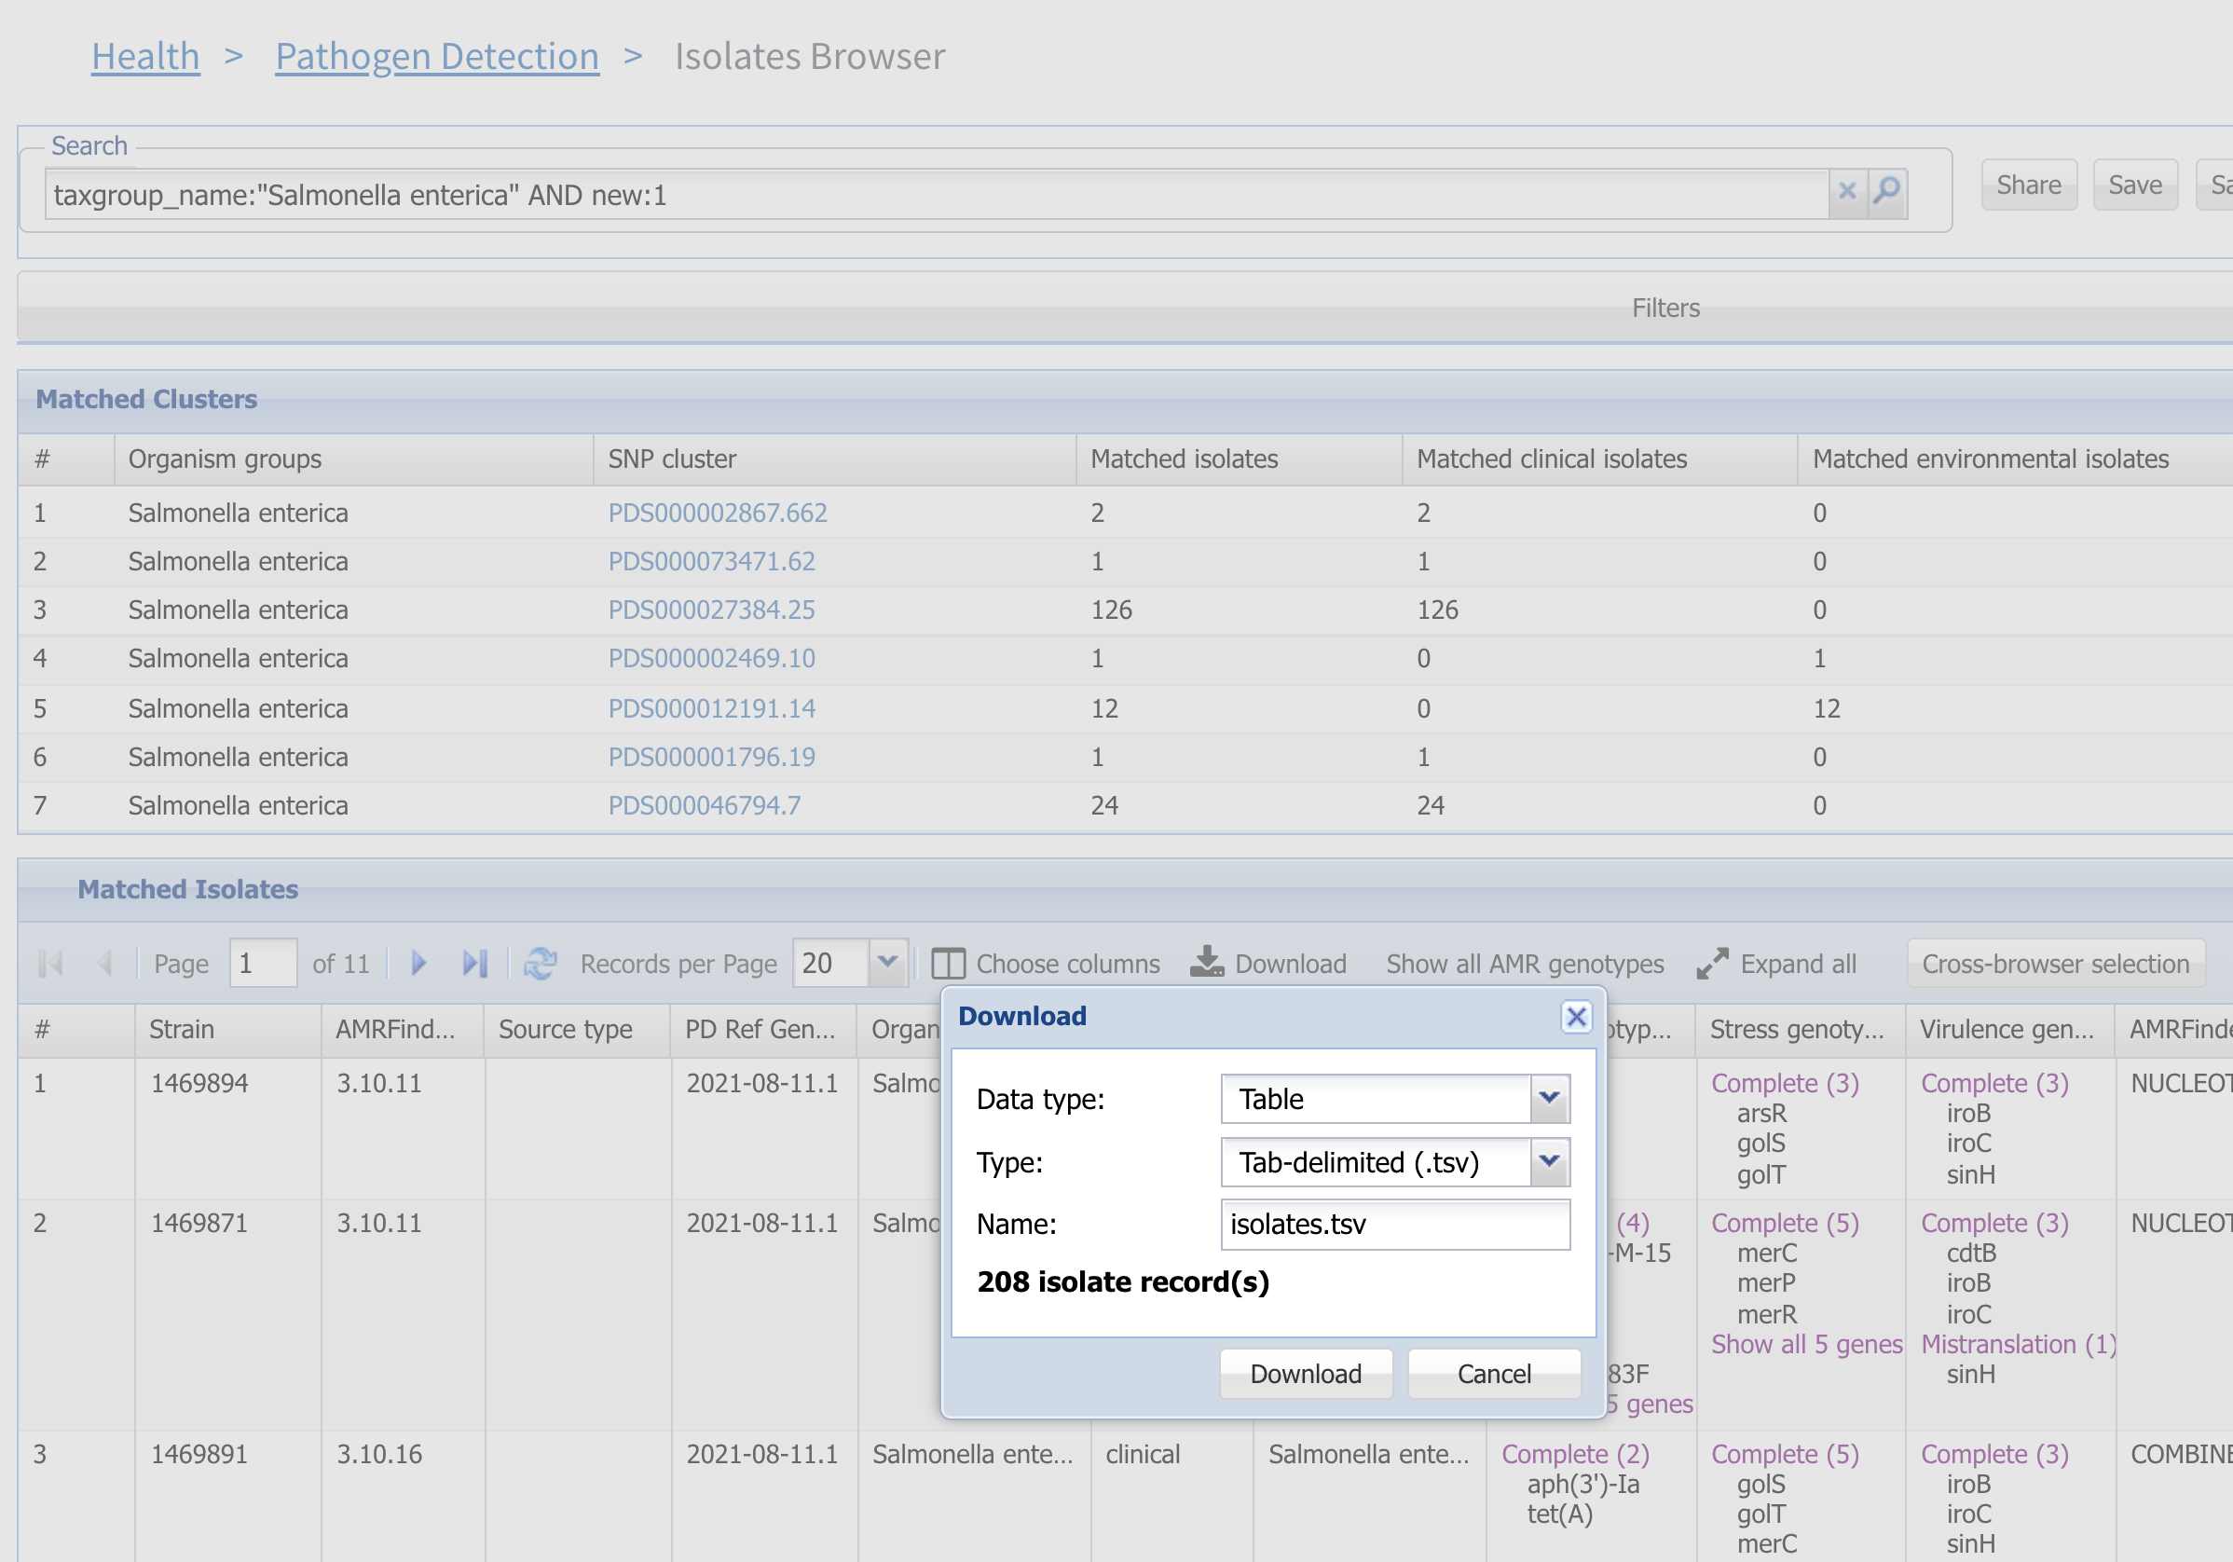
3. Click Download to get data in tab-delimited format

Slide 6
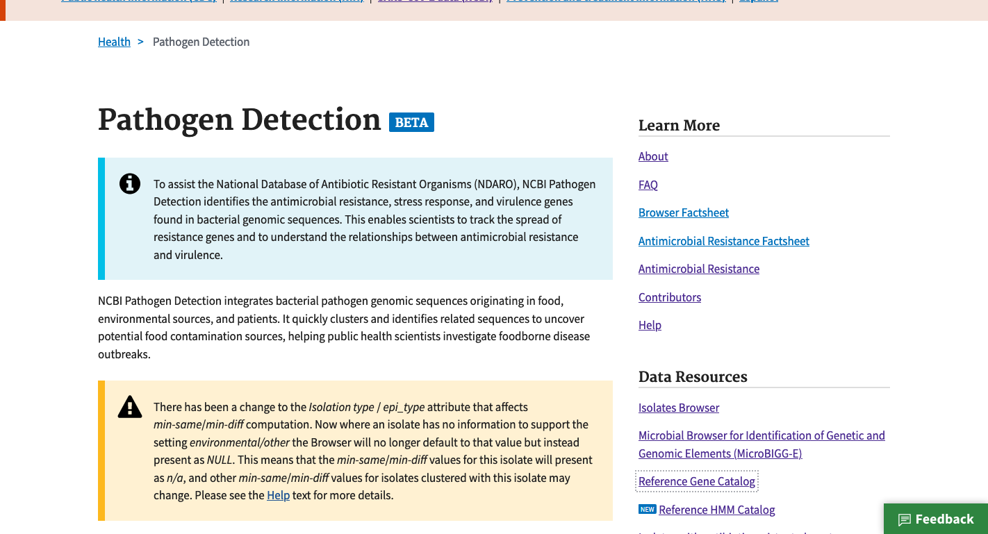
https://www.ncbi.nlm.nih.gov/pathogens
4. Click Isolate Browser

Slide 7
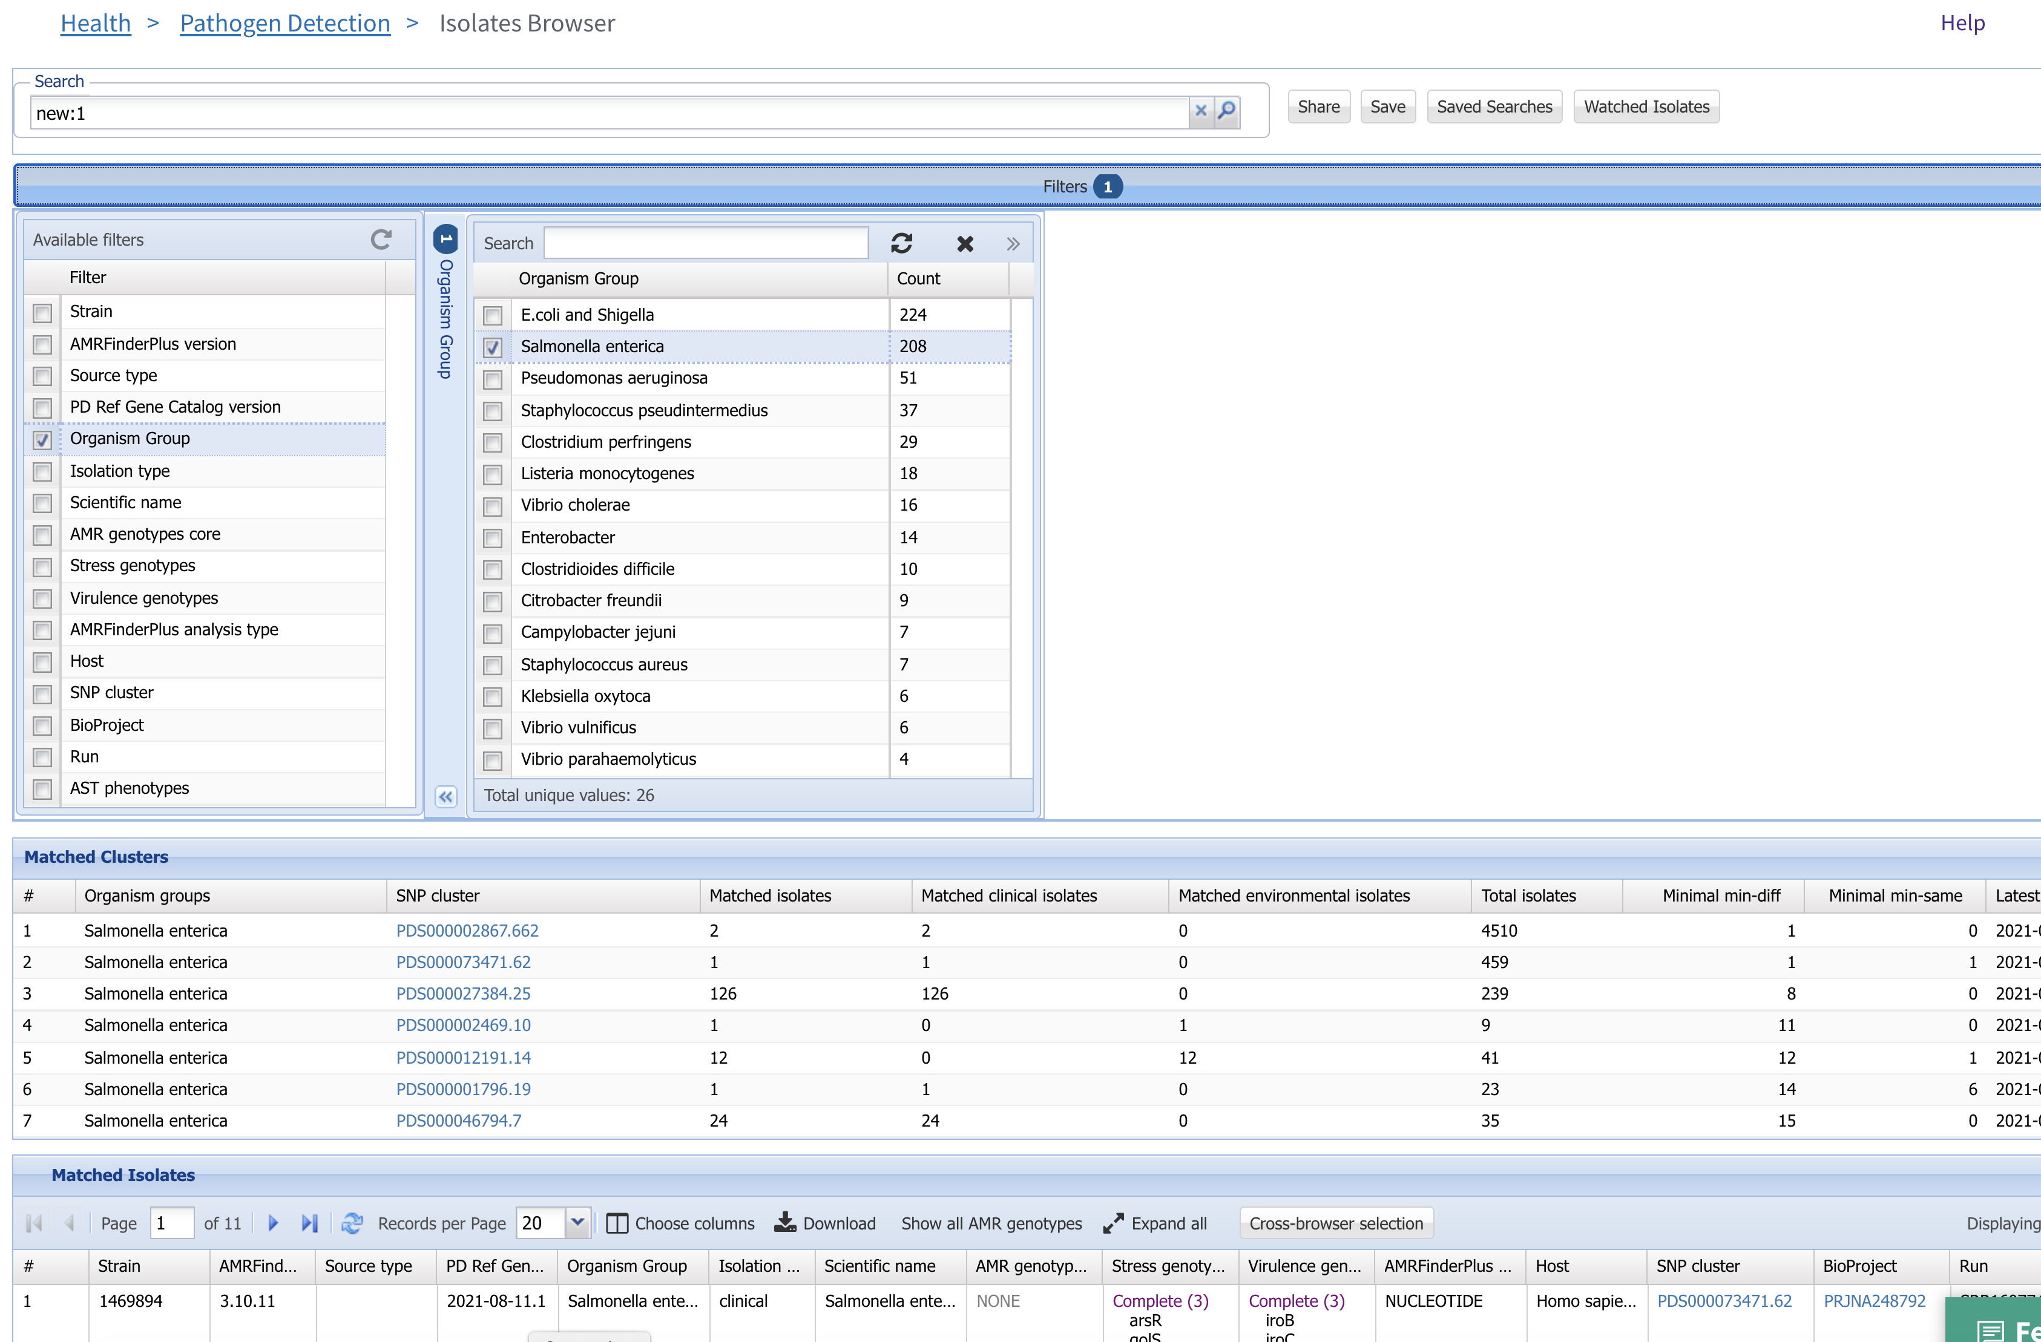
5. Use the syntax “new:1” in the search bar
6. Click Filters bar to show filters
8. Select Salmonella enterica
7. Click Organism Group and Isolation Type to show organism group and isolation type filters
9. Click Download button

Slide 8
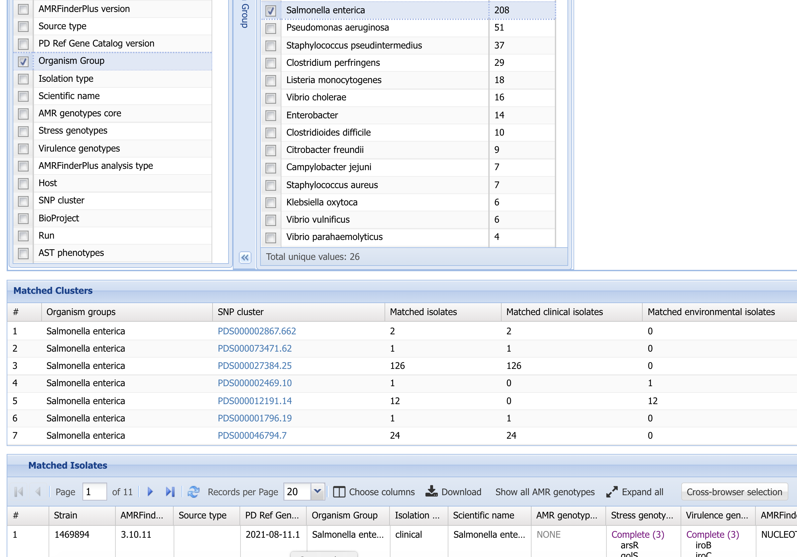
10. Click Download

Slide 9
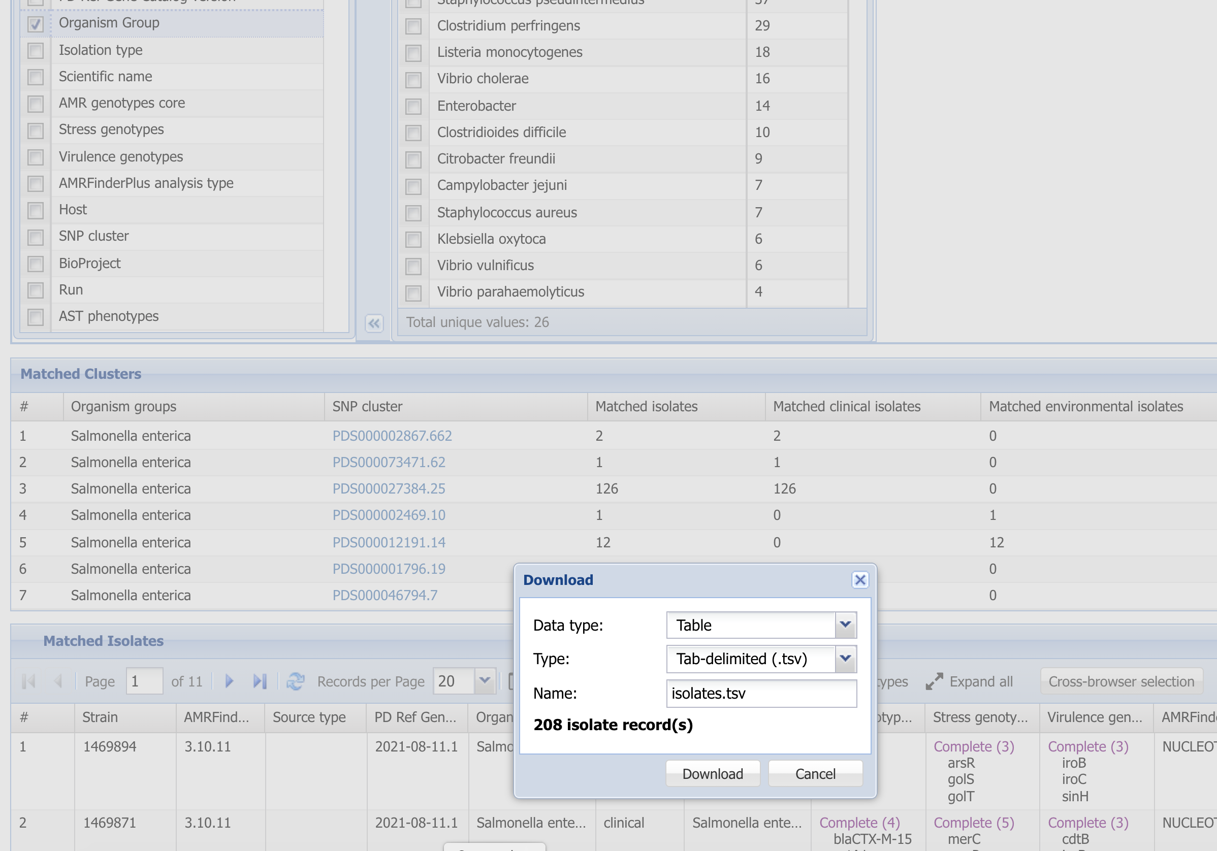
11. Click Download to get data in tab-delimited format

Slide 10
More information
For full help documentation of the Reference Gene Catalog see: https://www.ncbi.nlm.nih.gov/pathogens/pathogens_help/#reference-gene-catalog
For details about filters see:
https://www.ncbi.nlm.nih.gov/pathogens/pathogens_help/#refgene-filters
For details about the table downloads see:
https://www.ncbi.nlm.nih.gov/pathogens/pathogens_help/#refgene-access-download
Questions and further help: email pd-help@ncbi.nlm.nih.gov

