Slide 1
How To: Identify all the contigs that share a set of genes (e.g., blaTEM-1 and blaKPC-4)
NCBI Pathogen Detection https://www.ncbi.nlm.nih.gov/pathogens

Slide 2
How do I identify all the contigs that share a set of genes? (e.g., blaTEM-1 and blaKPC-4)
Use MicroBIGG-E
Use the search term genes_on_contig “genes_on_contig:blaTEM-1 AND genes_on_contig:blaKPC-4”
Download contigs fasta files

Slide 3
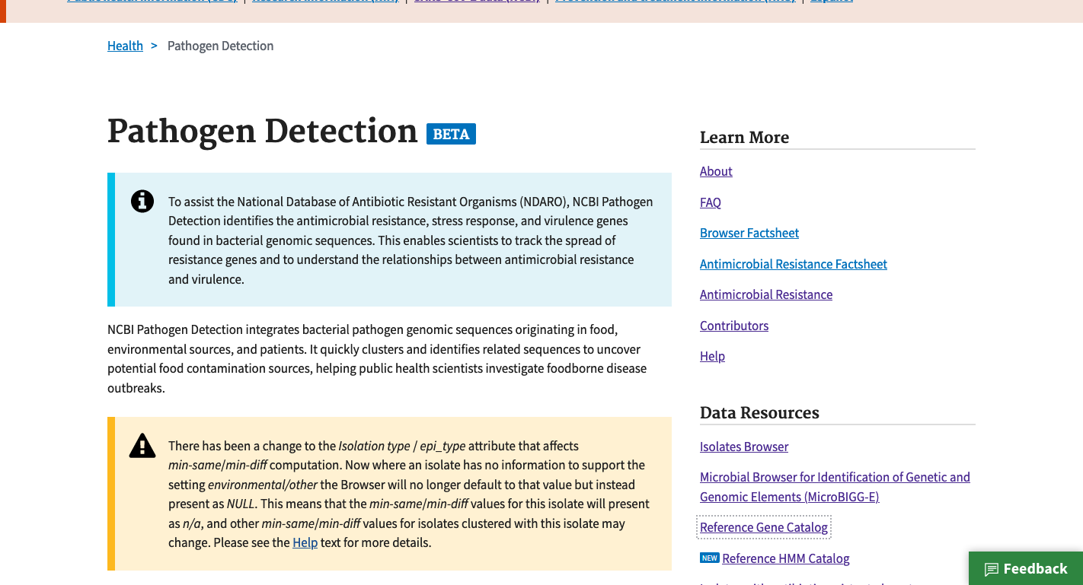
https://www.ncbi.nlm.nih.gov/pathogens
1. Click MicroBIGG-E

Slide 4
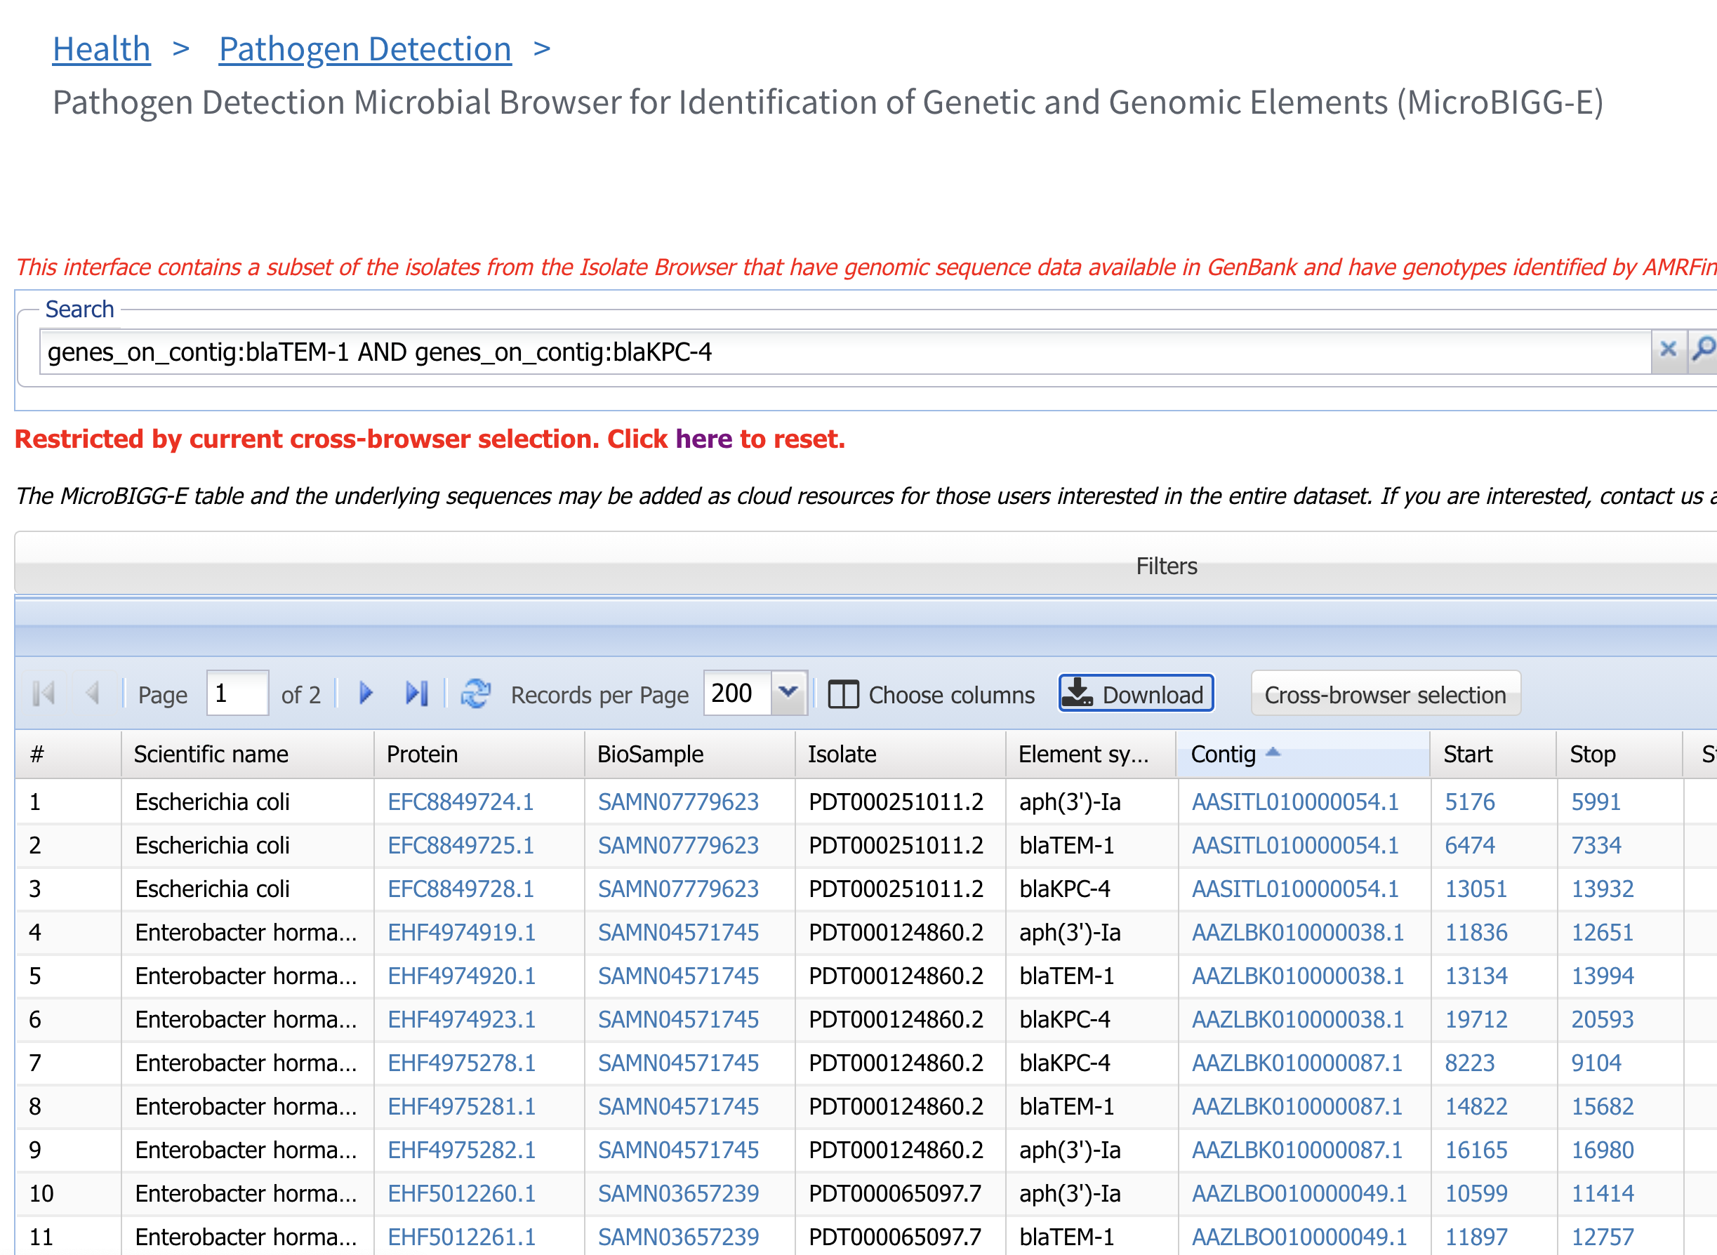
2. Use genes_on_contig command to identify contigs with blaTEM-1 and blaKPC-4
3. Click Download to obtain contig sequences or other data

Slide 5
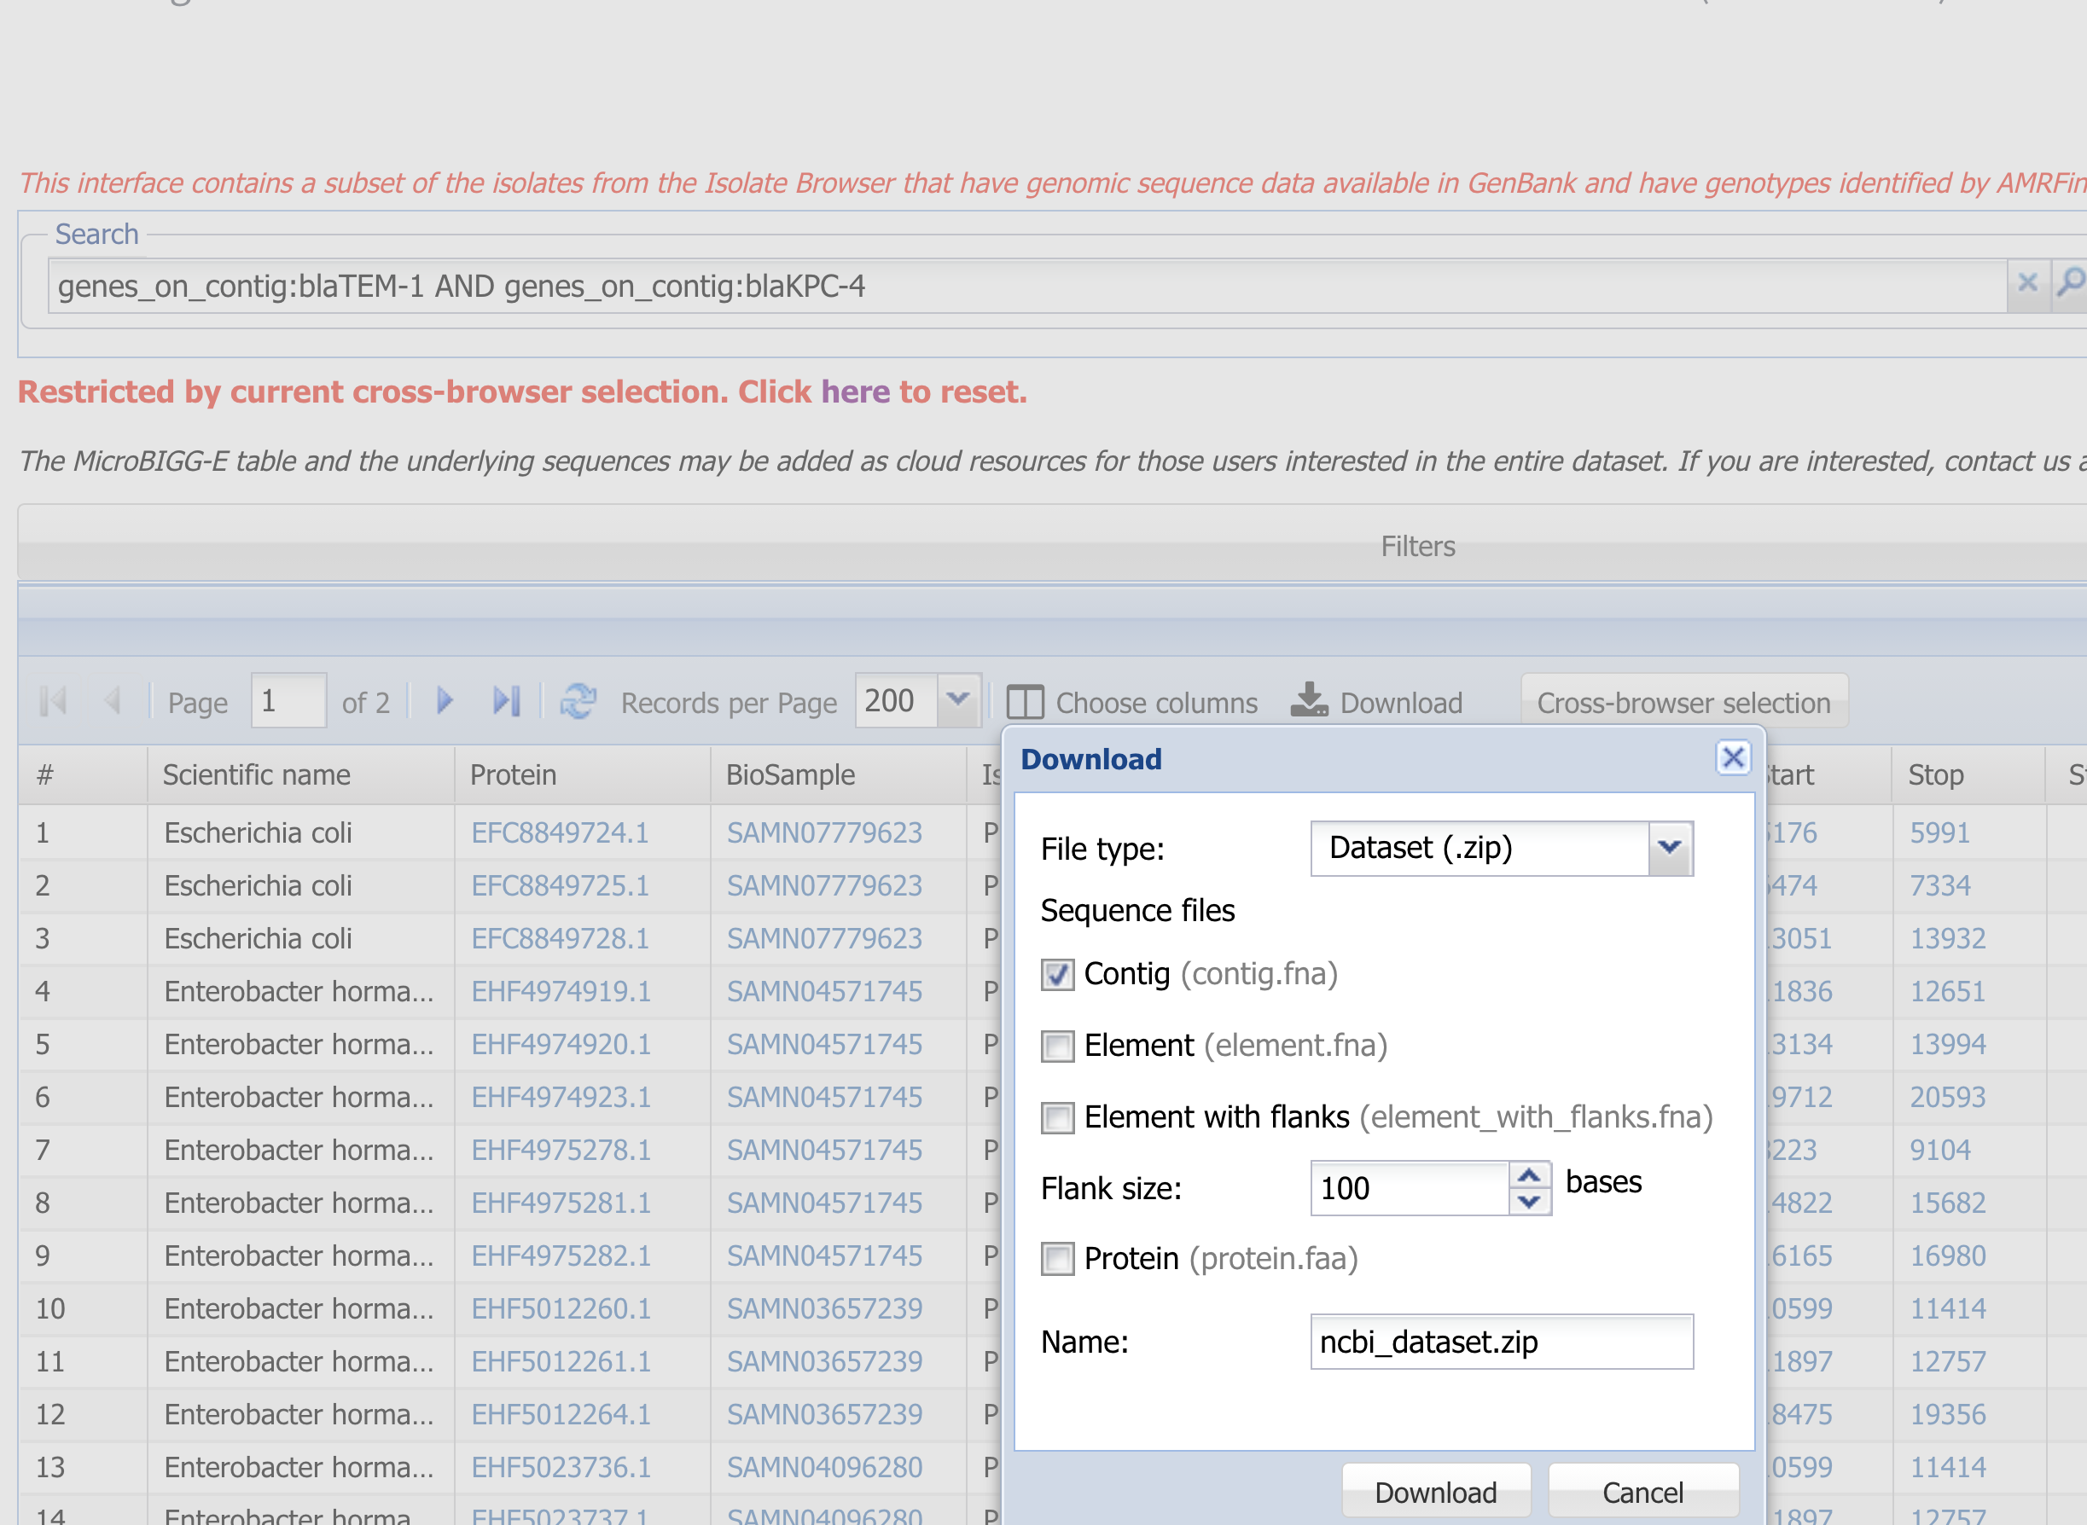
4. Select Contig to download nucleotide sequences of all contigs that contain blaTEM-1 and blaKPC-4
5. Can edit the name of the download file.

Slide 6
More information
For full help documentation of the Reference Gene Catalog see: https://www.ncbi.nlm.nih.gov/pathogens/pathogens_help/#reference-gene-catalog
For details about filters see:
https://www.ncbi.nlm.nih.gov/pathogens/pathogens_help/#refgene-filters
For details about the table downloads see:
https://www.ncbi.nlm.nih.gov/pathogens/pathogens_help/#refgene-access-download
Questions and further help: email pd-help@ncbi.nlm.nih.gov

