Slide 1
How To: Cite the Pathogen Detection Resource and the Data Contained Within
NCBI Pathogen Detection https://www.ncbi.nlm.nih.gov/pathogens

Slide 2
At a glance
WARNING: Although the data in Pathogen Detection uses an accession.version system similar to other NCBI
databases, due to the high turnover of analysis results, only a limited ‘history’ of these objects are kept.
If citing the entire resource without using a subset of data, use the date
the website was accessed
If a subset of data is used, include the identifiers from the data archives (SRA, BioSample, GenBank/Assembly) as well as the Pathogen Detection specific identifiers (PDG, PDT, PDS)
If a subset of data is used, acknowledge the original submitters in your presentation or manuscript
If citing one of the methods used in Pathogen Detection, cite the appropriate
published paper

Slide 3
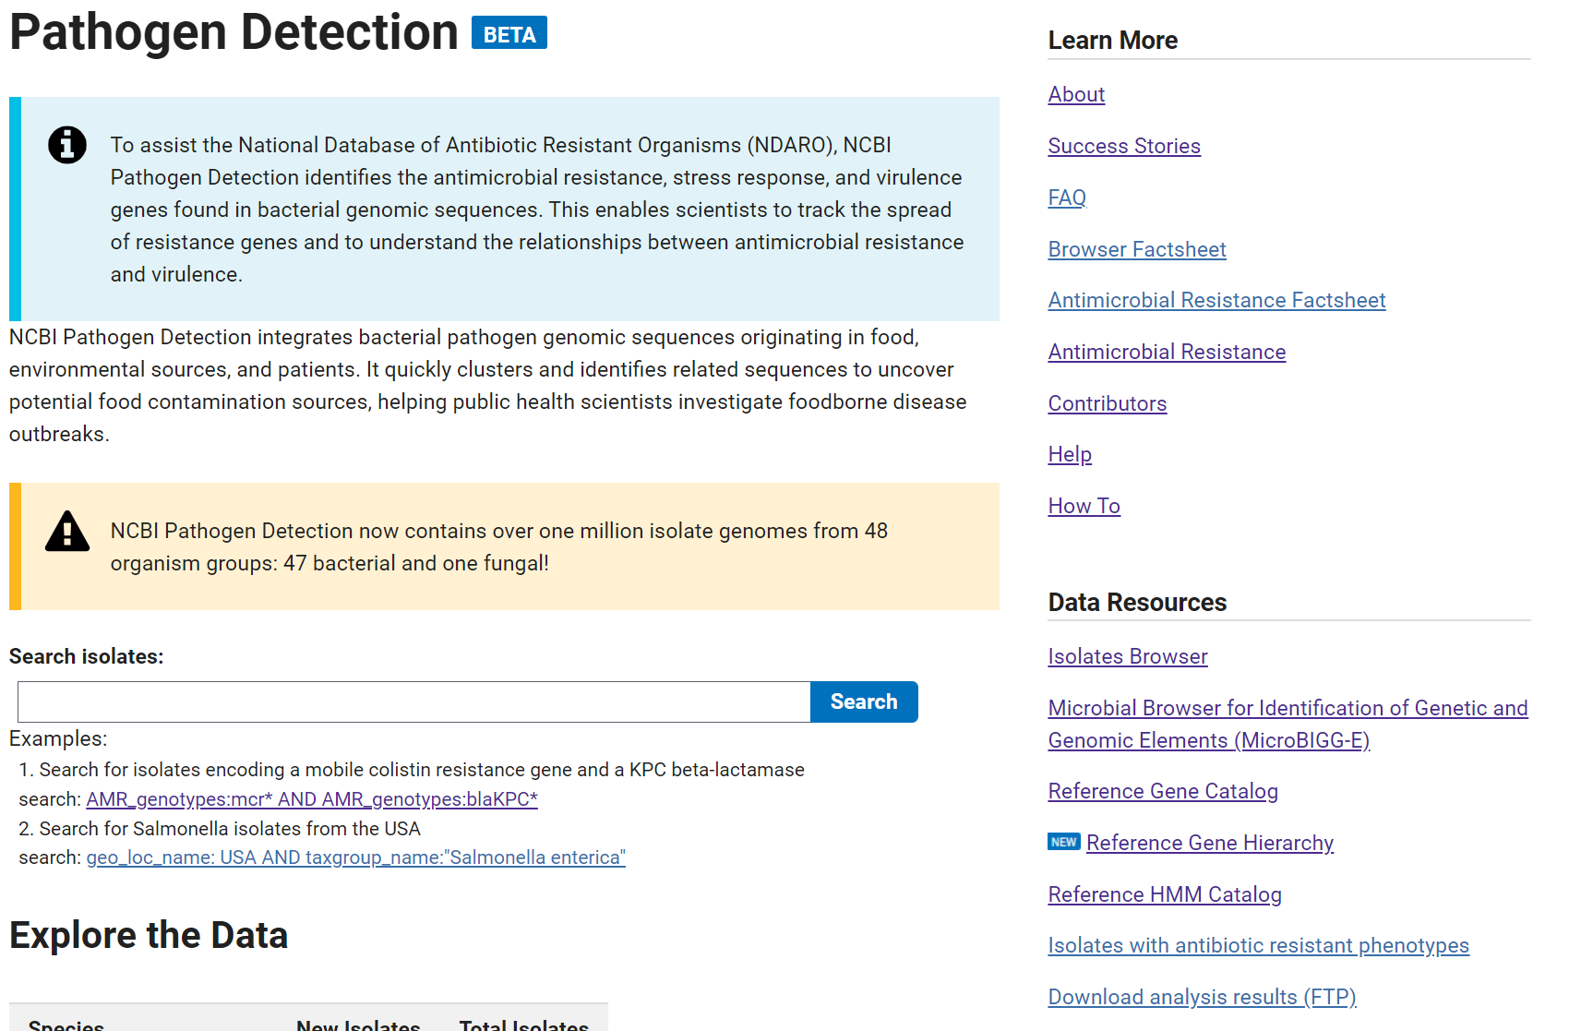
https://www.ncbi.nlm.nih.gov/pathogens
1. Note the date the website was accessed
2. If using the Isolates Browser proceed to the next page
3. If using the MicroBIGG-E proceed to page 7
4. If using NCBI AMR resources cite the appropriate publication

Slide 4
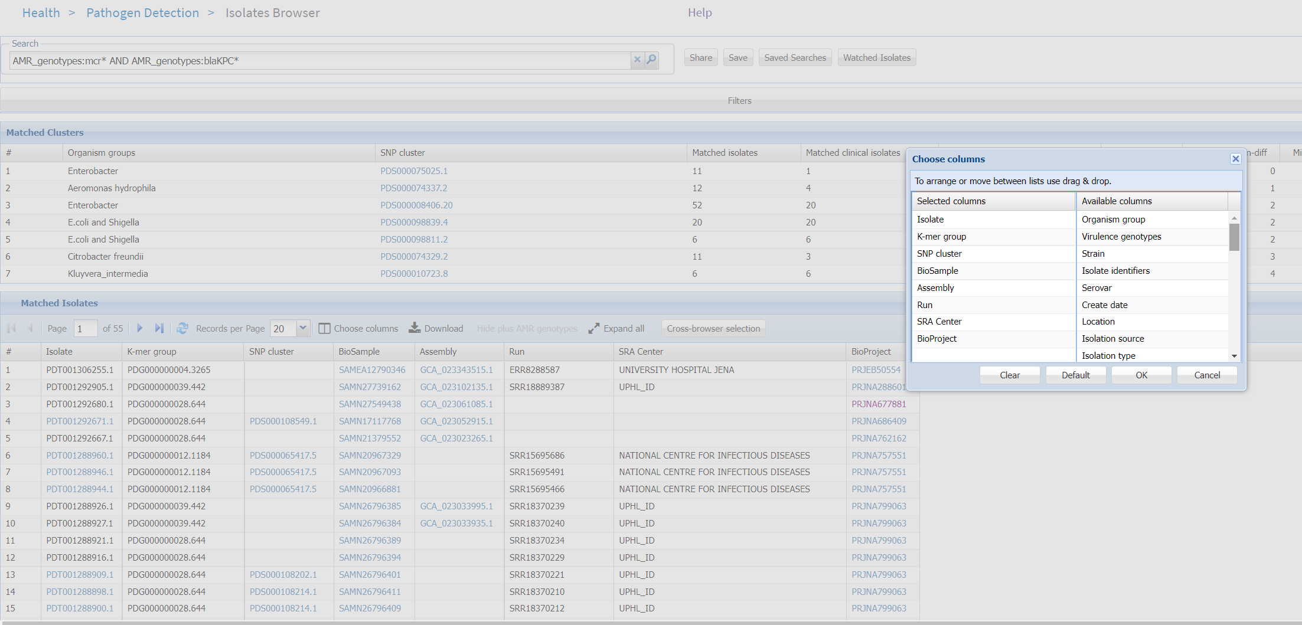
5. If using a subset of data (search, filter, etc.) choose these columns

Slide 5
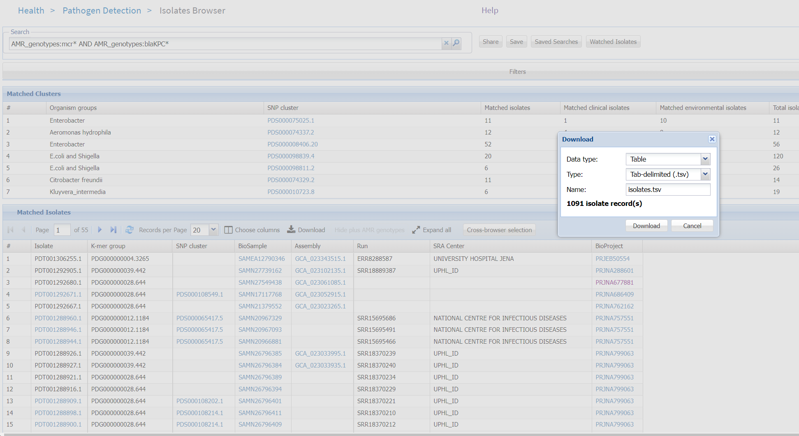
6. Then download the table and use it in the supplementary data for your paper

Slide 6
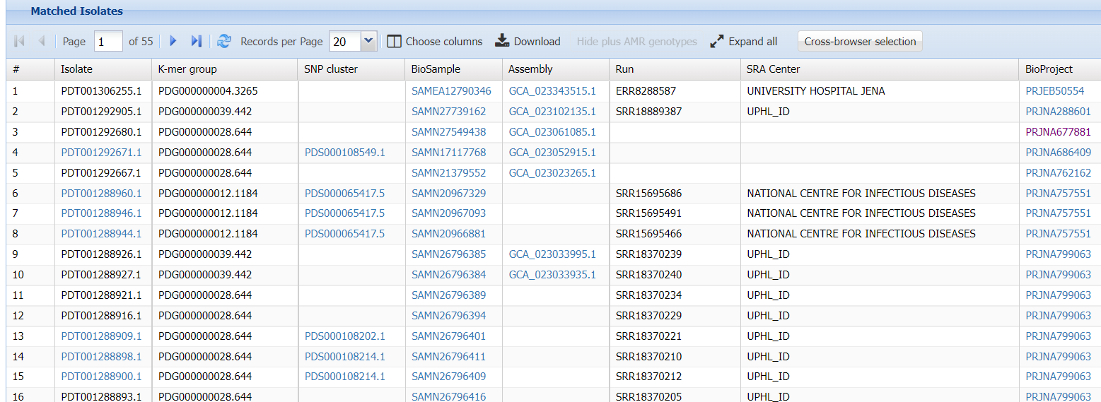
Assemblies submitted to GenBank will have the submitter information
SRA Center for data submitted to SRA from large-scale sequencing initiatives
BioProjects encompass multiple data items and typically describe an ‘initiative’ or consortium to which the data are submitted
7. Acknowledge the appropriate data submitters in your manuscript

Slide 7
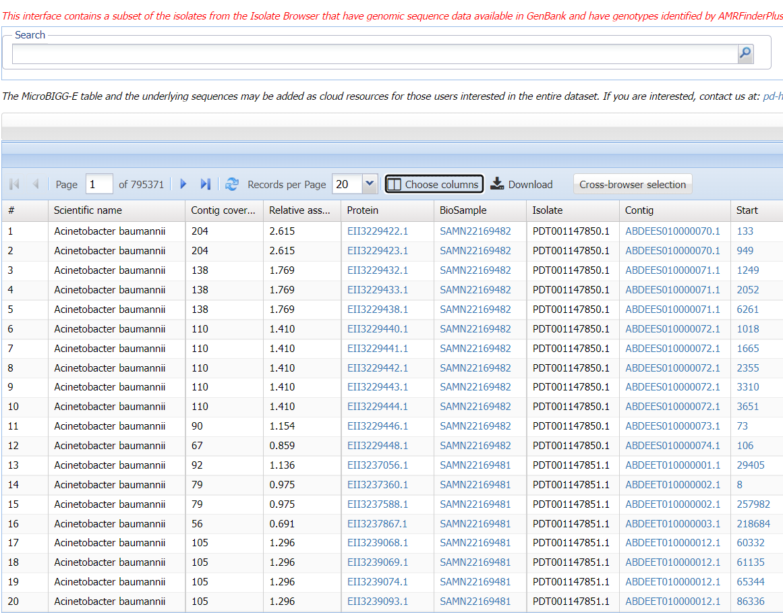
8. If using the MicroBIGG-E connect to the Isolate Browser using Cross-browser selection to obtain the submitted identifiers

Slide 8
More information
For information on different accessions in Pathogen Detection see:
https://www.ncbi.nlm.nih.gov/pathogens/pathogens_help/#unique-identifiers
For full details on data retention see:
https://www.ncbi.nlm.nih.gov/pathogens/pathogens_help/#data-retention
For citing the Pathogen Detection site see:
https://www.ncbi.nlm.nih.gov/pathogens/pathogens_help/#citing
For citing specific methods used in Pathogen Detection see:
https://www.ncbi.nlm.nih.gov/pathogens/pathogens_help/#references-methods
Questions and further help: email pd-help@ncbi.nlm.nih.gov

