Slide 1
How To: Find, using the MicroBIGG-E Map, blaKPC-containing Klebsiella pneumoniae isolates from China and the U.S. in the Isolates Browser
NCBI Pathogen Detection https://www.ncbi.nlm.nih.gov/pathogens

Slide 2
At a glance
Use the MicroBIGG-E Map
https://www.ncbi.nlm.nih.gov/pathogens/microbigge_map/
Select "Klebsiella pneumoniae" from the Organism Group dropdown menu
Select "Element symbol" in Filters and search for "blaKPC"
Use the MicroBIGG-E International Map Panel to restrict data to isolates from China and the U.S.
Use the Cross-Browser option to display selected isolates in the Isolates Browser

Slide 3
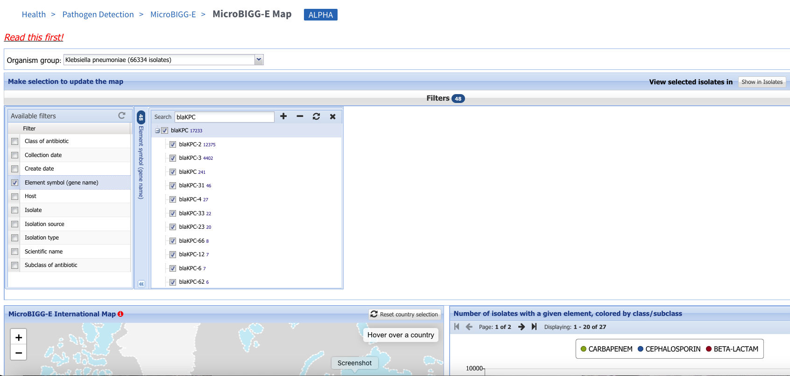
https://www.ncbi.nlm.nih.gov/pathogens/microbigge_map/
2. Select Klebsiella pneumoniae as Organism group
4. Enter “blaKPC” in filter panel search bar
5. Select blaKPC in filter
3. Select Element symbol

Slide 4
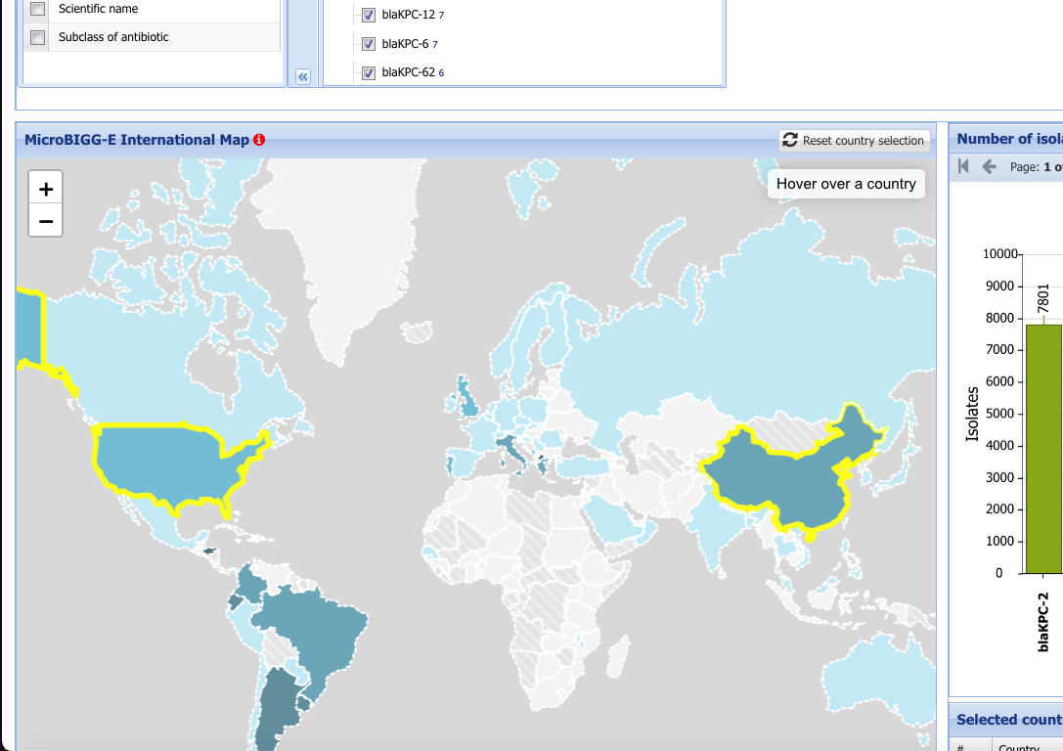
https://www.ncbi.nlm.nih.gov/pathogens/microbigge_map/
6. Select China by clicking its outline
7. Select the U.S. by clicking its outline

Slide 5
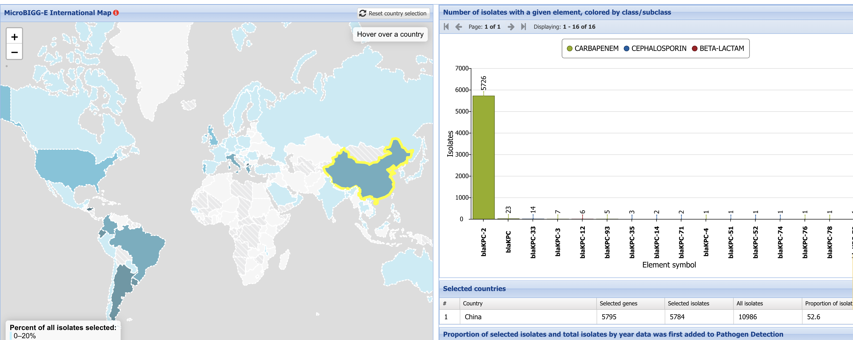
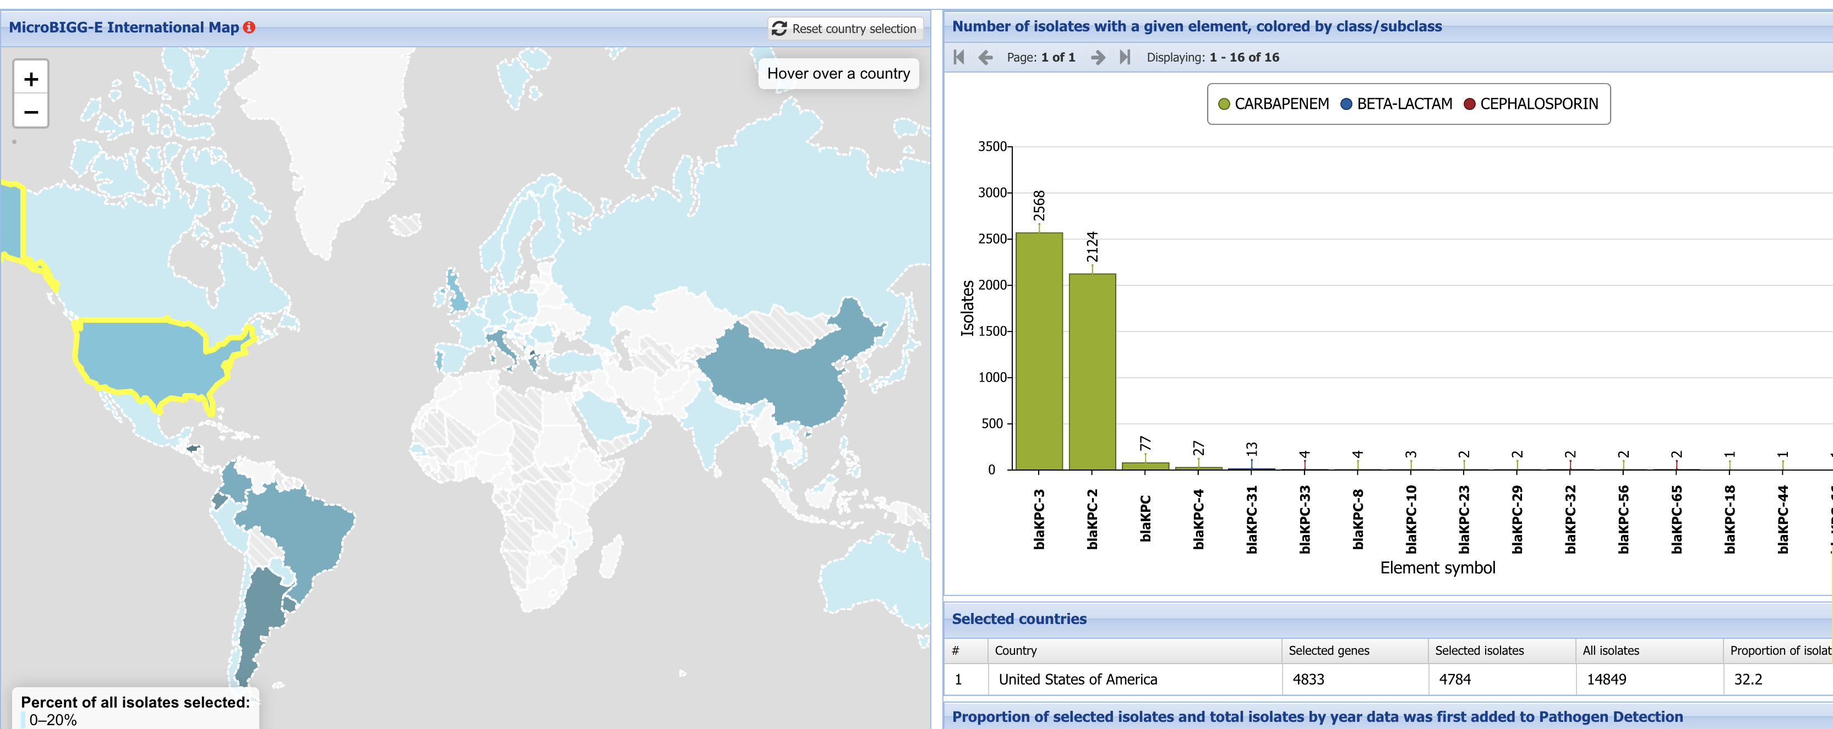
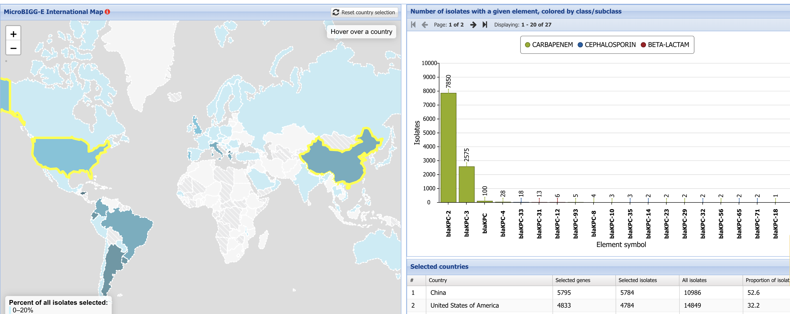
https://www.ncbi.nlm.nih.gov/pathogens/microbigge_map/
8. Select China to show the distribution of KPC alleles in isolates from China
10. Select both China and the U.S. to show the distribution of KPC alleles in isolates from both countries combined
Note the difference in KPC allele distributions between the two countries
9. Select the U.S. to show the distribution of KPC alleles in isolates from the U.S.

Slide 6
https://www.ncbi.nlm.nih.gov/pathogens/microbigge_map/
11. Select the “Show in Isolates” button

Slide 7
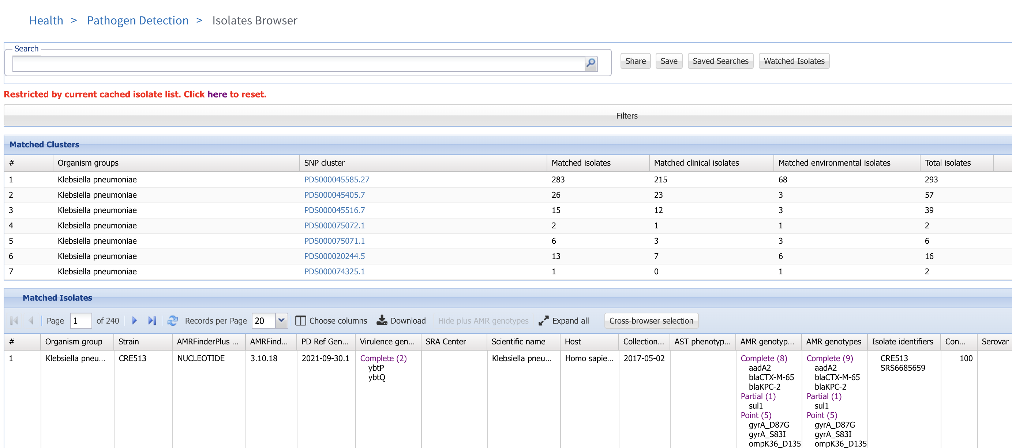
https://www.ncbi.nlm.nih.gov/pathogens/microbigge_map/
12. You can work with the data in the Isolates Browser, such as examining this large cluster composed of mostly KPC-containing isolates

Slide 8
More information
For full help documentation of the MicroBIGG-E Map see: LINK
For full help documentation of MicroBIGG-E see:
https://www.ncbi.nlm.nih.gov/pathogens/pathogens_help/#microbigge
Questions and further help: email pd-help@ncbi.nlm.nih.gov

