Slide 1
How To: Download, using the MicroBIGG-E Map, blaKPC nucleotide sequences from Klebsiella pneumoniae isolates from China and the U.S.
NCBI Pathogen Detection https://www.ncbi.nlm.nih.gov/pathogens

Slide 2
At a glance
Use the MicroBIGG-E Map
https://www.ncbi.nlm.nih.gov/pathogens/microbigge_map/
Select "Klebsiella pneumoniae" from the Organism Group dropdown menu
Select "Element symbol" in Filters and search for "blaKPC"
Use the MicroBIGG-E International Map Panel to restrict data to isolates from China and the U.S.
Use the Cross-Browser option to display selected isolates in MicroBIGG-E
In MicroBIGG-E, select "Download"
In the Download pop-up, select "Dataset (.zip)"
Select the "Element" box
Select Download

Slide 3
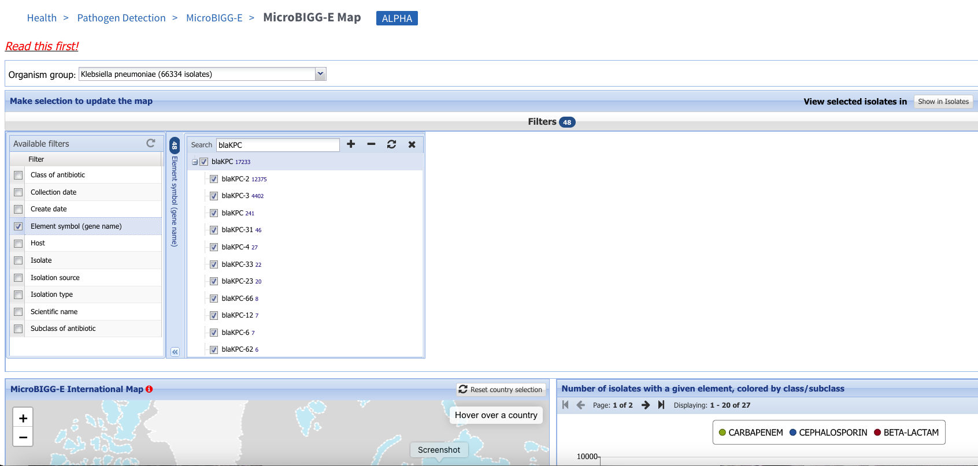
https://www.ncbi.nlm.nih.gov/pathogens/microbigge_map/
2. Select Klebsiella pneumoniae as Organism group
4. Enter “blaKPC” in filter panel search bar
5. Select blaKPC in filter
3. Select Element symbol

Slide 4
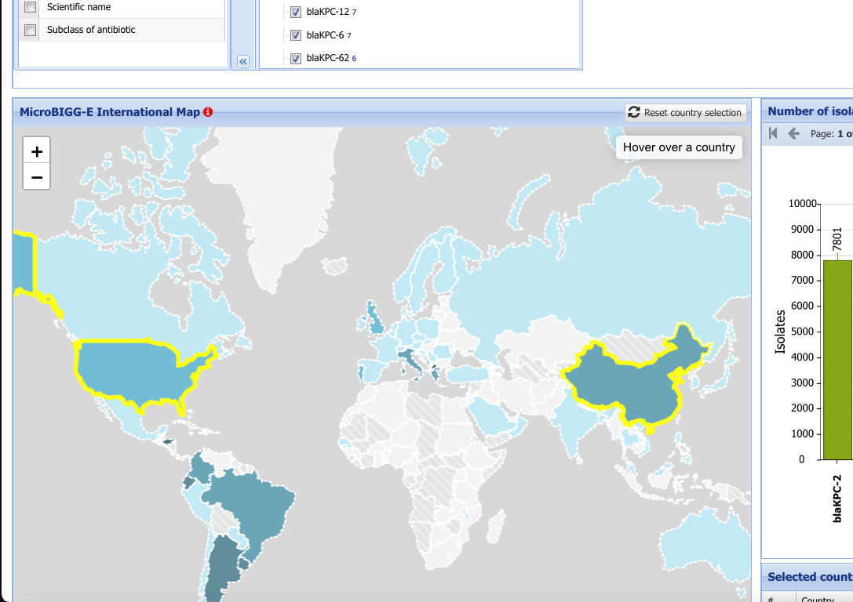
https://www.ncbi.nlm.nih.gov/pathogens/microbigge_map/
6. Select China by clicking its outline
7. Select the U.S. by clicking its outline

Slide 5
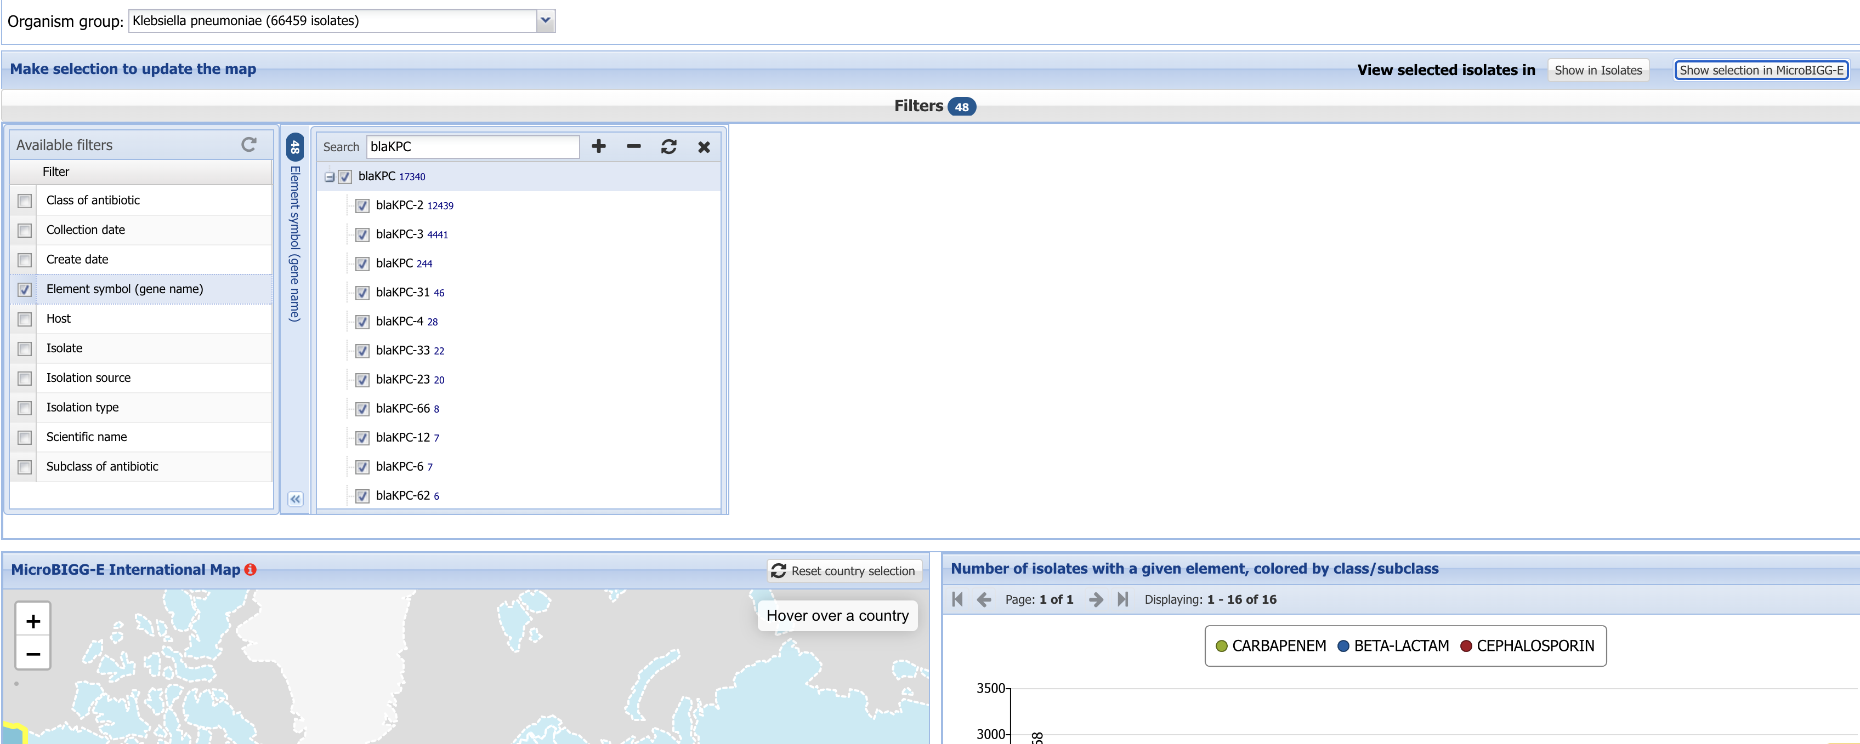
https://www.ncbi.nlm.nih.gov/pathogens/microbigge_map/
8. Select the “Show in MicroBIGG-E” button

Slide 6
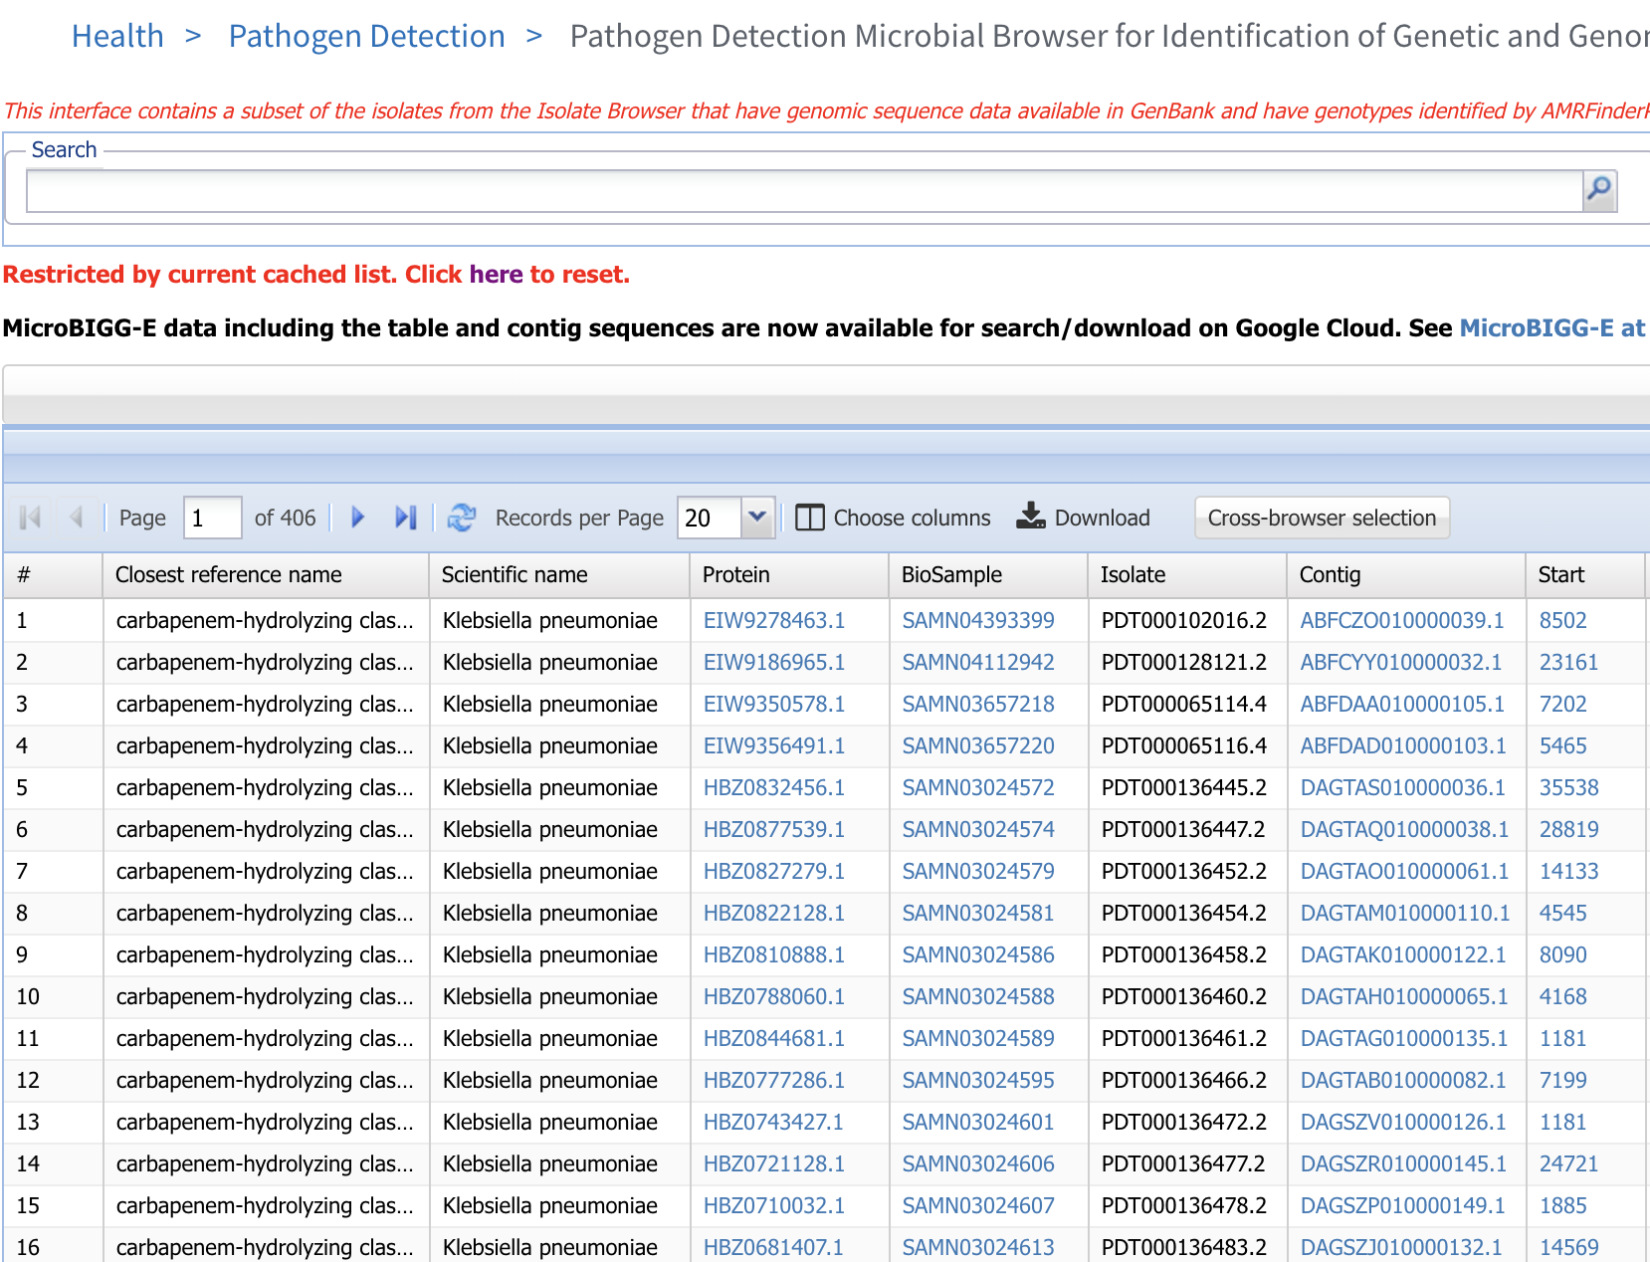
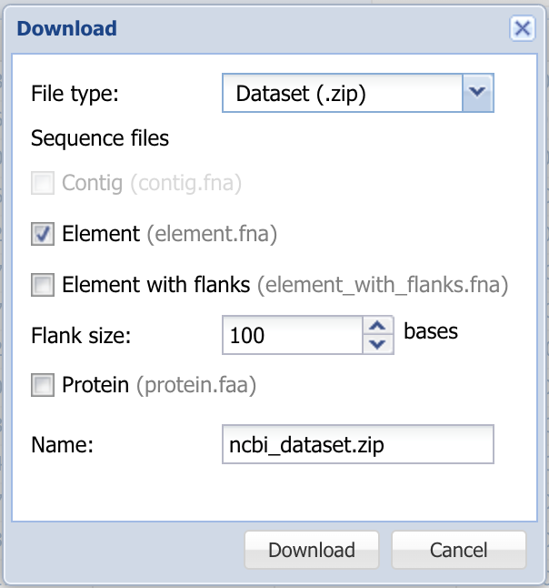
https://www.ncbi.nlm.nih.gov/pathogens/microbigge_map/
9. Select the “Download” button
10. Select the “Element” button
11. Select the “Download” button to download a fasta format file of nucleotide sequence

Slide 7
More information
For full help documentation of the MicroBIGG-E Map see: LINK
For full help documentation of MicroBIGG-E see:
https://www.ncbi.nlm.nih.gov/pathogens/pathogens_help/#microbigge
Questions and further help: email pd-help@ncbi.nlm.nih.gov

