Slide 1
How To: Find all the known resistance mechanisms to a given drug (e.g., chloramphenicol)
NCBI Pathogen Detection https://www.ncbi.nlm.nih.gov/pathogens

Slide 2
How do I find all the known resistance mechanisms to a given drug (e.g., chloramphenicol)?
Use the Reference Gene Catalog
Use filters or search to select subclass “CHLORAMPHENICOL”
Download table displaying information about these resistance mechanisms

Slide 3
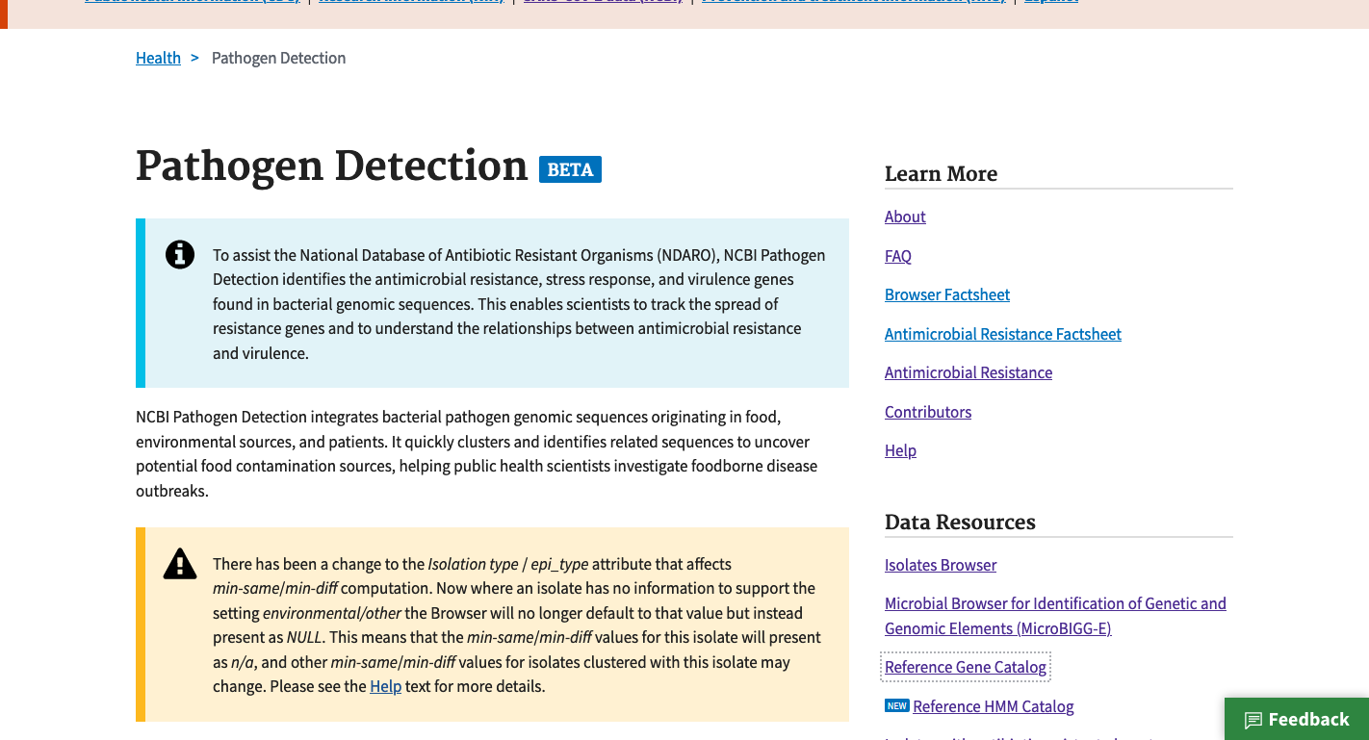
https://www.ncbi.nlm.nih.gov/pathogens
1. Click Reference Gene Catalog

Slide 4
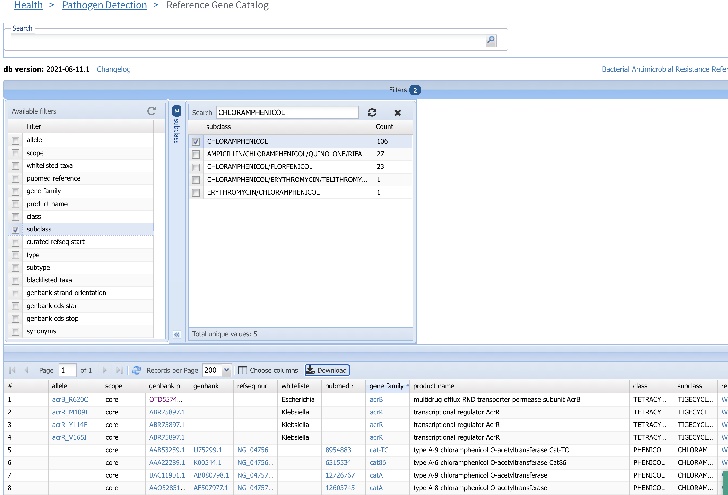
2. Click Filters bar to show filters
4. Enter CHLORAMPHENICOL in subclass search window
5. Select CHLORAMPHENICOL to display chloramphenicol resistance mechanisms
6. If you want to display chloramphenicol resistance mechanisms that also confer resistance to other drugs, you can select the other boxes
3. Select subclass to show the subclass filter

Slide 5
7. Click Download

Slide 6
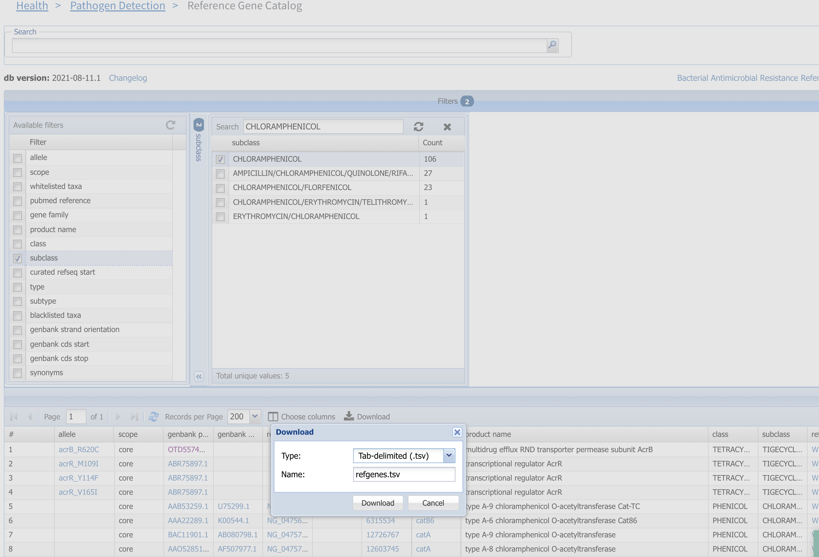
8. Click Download to download table

Slide 7
More information
For full help documentation of the Reference Gene Catalog see: https://www.ncbi.nlm.nih.gov/pathogens/pathogens_help/#reference-gene-catalog
For details about filters see:
https://www.ncbi.nlm.nih.gov/pathogens/pathogens_help/#refgene-filters
For details about the table downloads see:
https://www.ncbi.nlm.nih.gov/pathogens/pathogens_help/#refgene-access-download
Questions and further help: email pd-help@ncbi.nlm.nih.gov

