Slide 1
How To: Download all the reference sequences for a set of proteins (e.g., all aac(6')-Ib sequences)
NCBI Pathogen Detection https://www.ncbi.nlm.nih.gov/pathogens

Slide 2
How do I download all the reference sequences for a set of proteins? (e.g., all aac(6')-Ib sequences)
Use MicroBIGG-E
Use filters or search to select gene family “aac(6’)-Ib*”
Download table containing protein accessions
Use Batch Entrez to download proteins

Slide 3
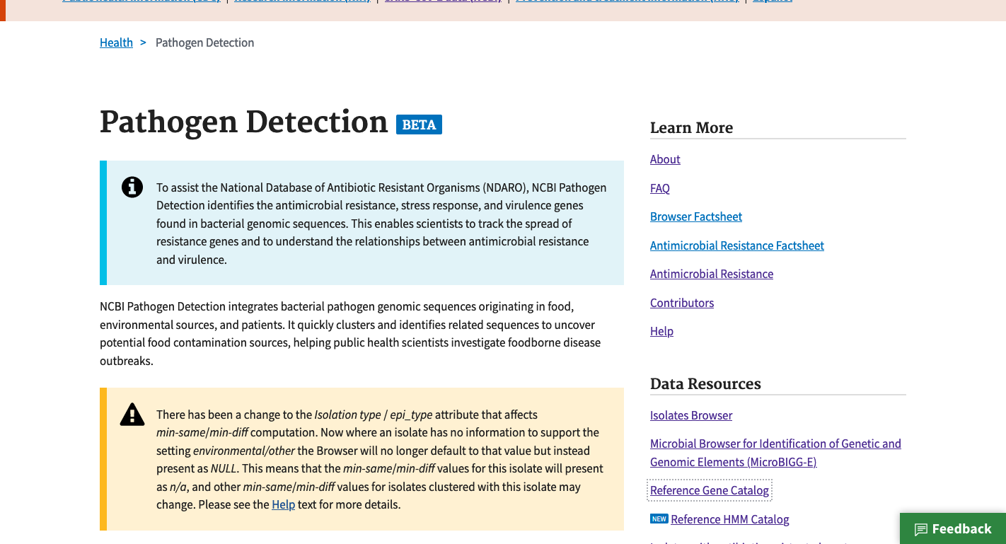
https://www.ncbi.nlm.nih.gov/pathogens
1. Click Reference Gene Catalog

Slide 4
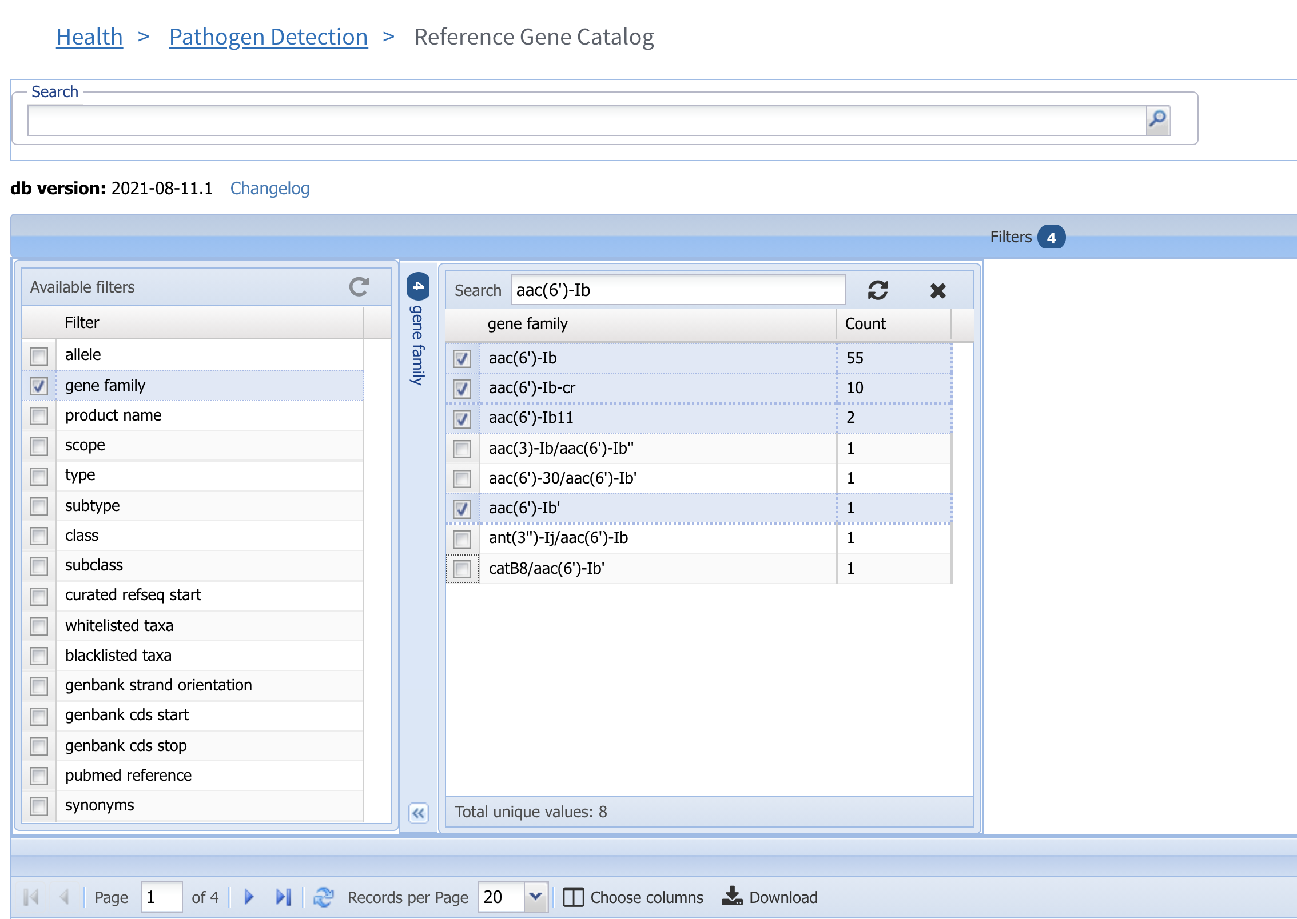
2. Click Filters bar to show filters
4. Enter “aac(6’)-Ib” and select the gene families of interest
3. Select gene family to show the gene family filter

Slide 5
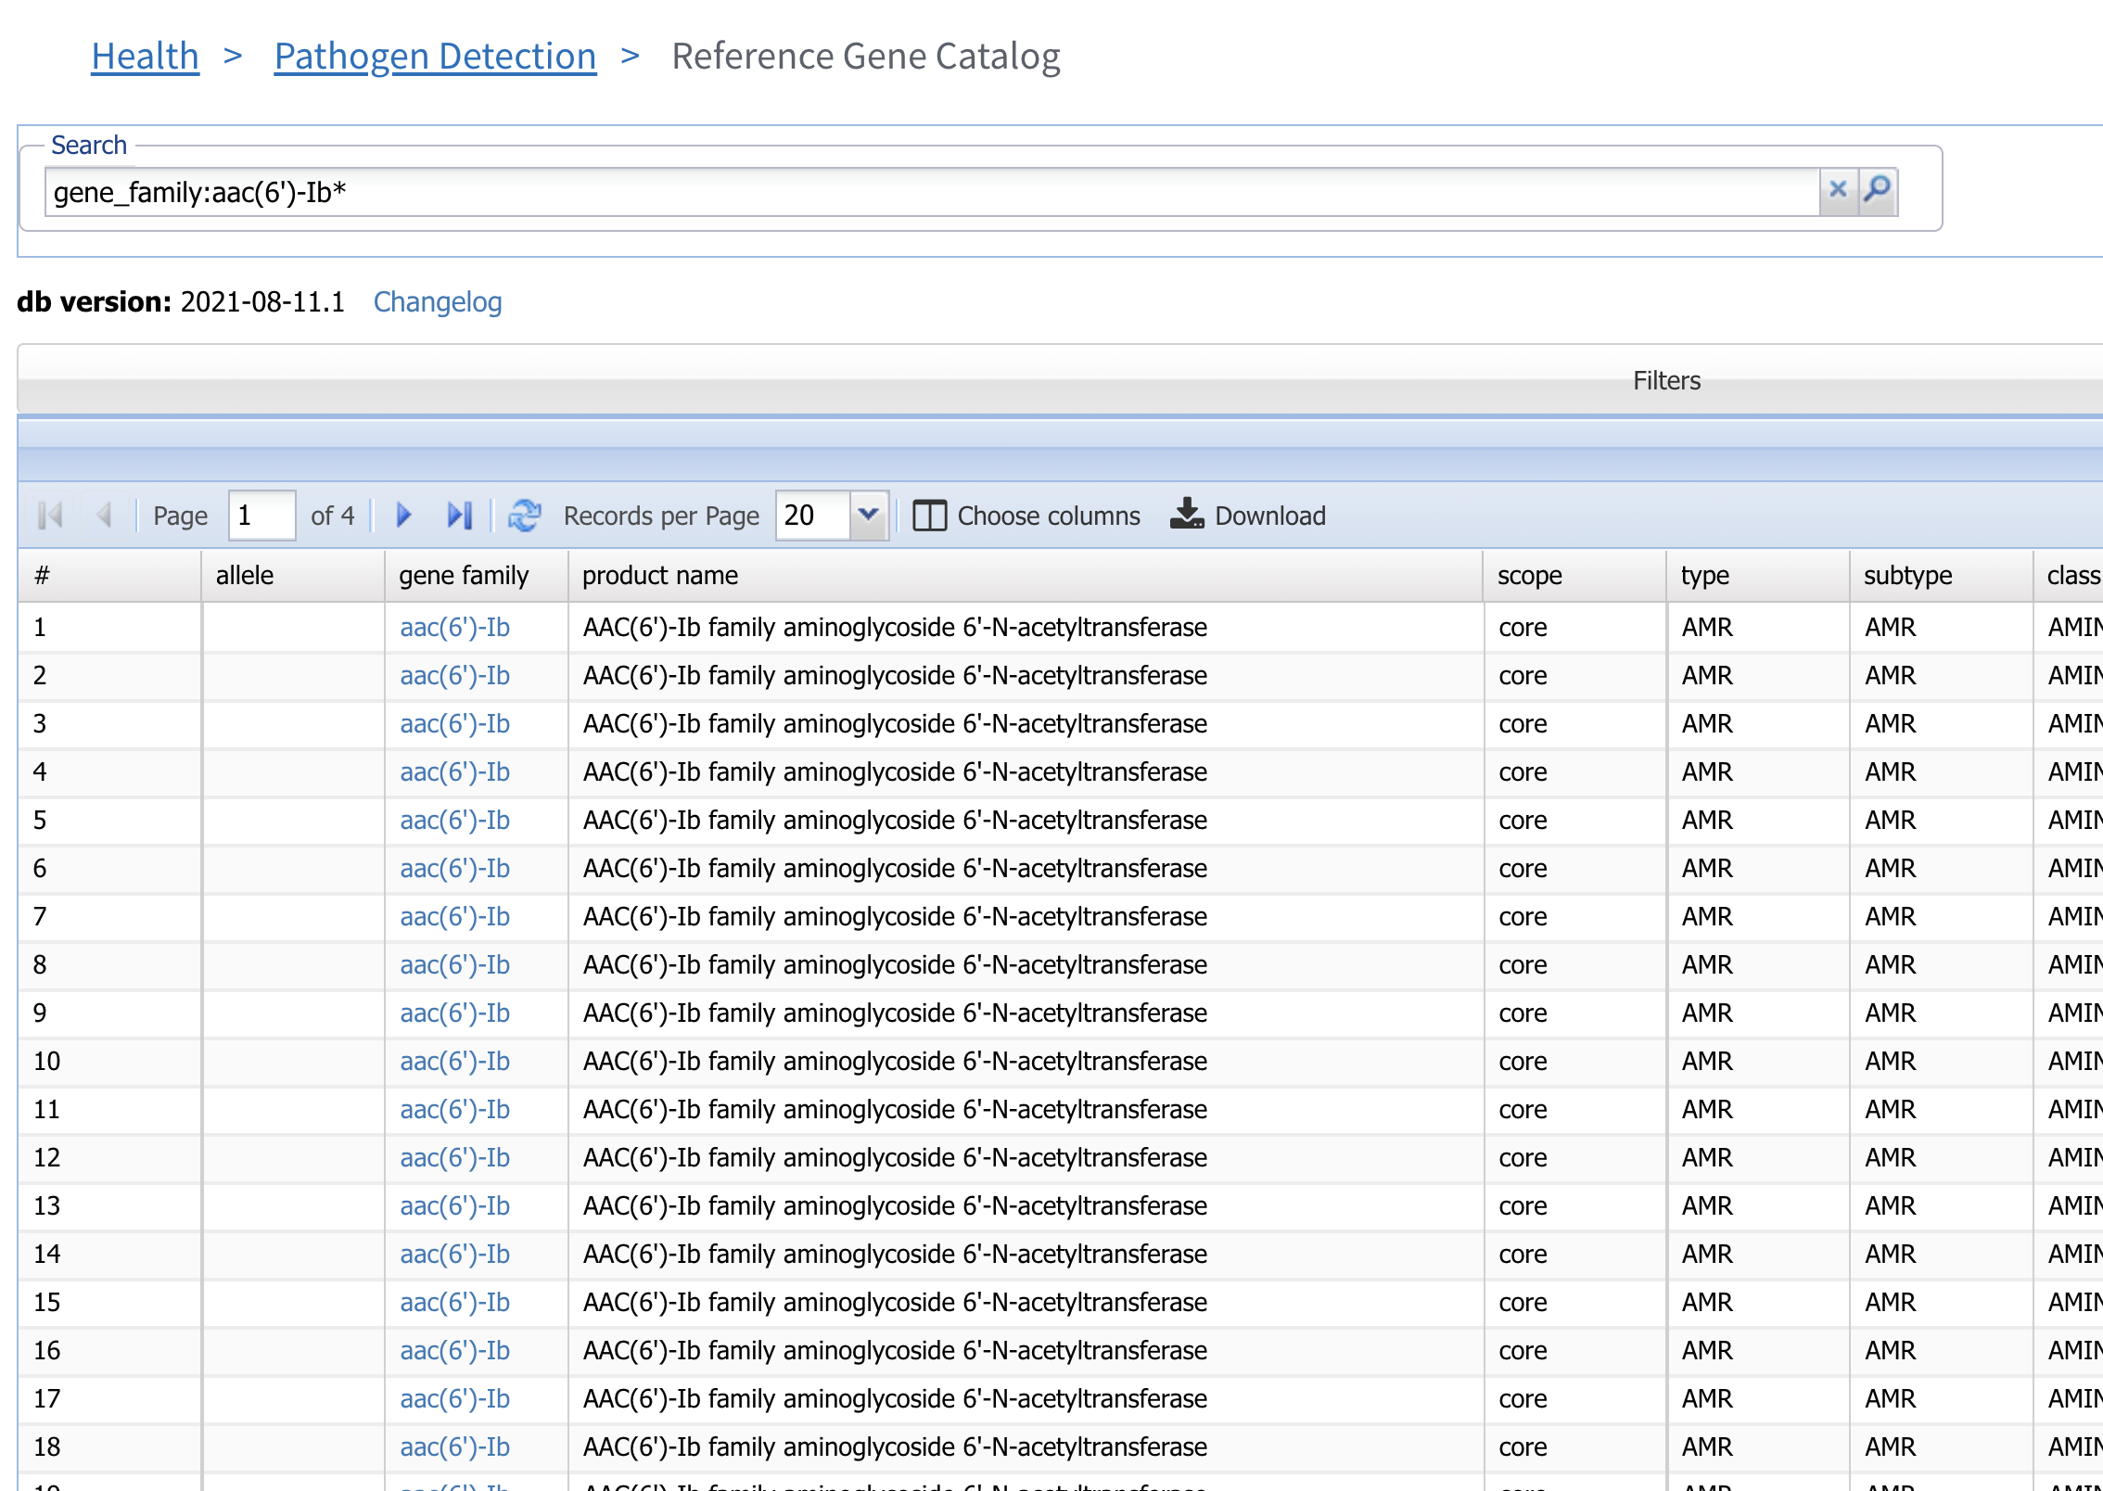
5. Alternatively, use the search term “gene_family” to find the aac(6’)-Ib family members

Slide 6
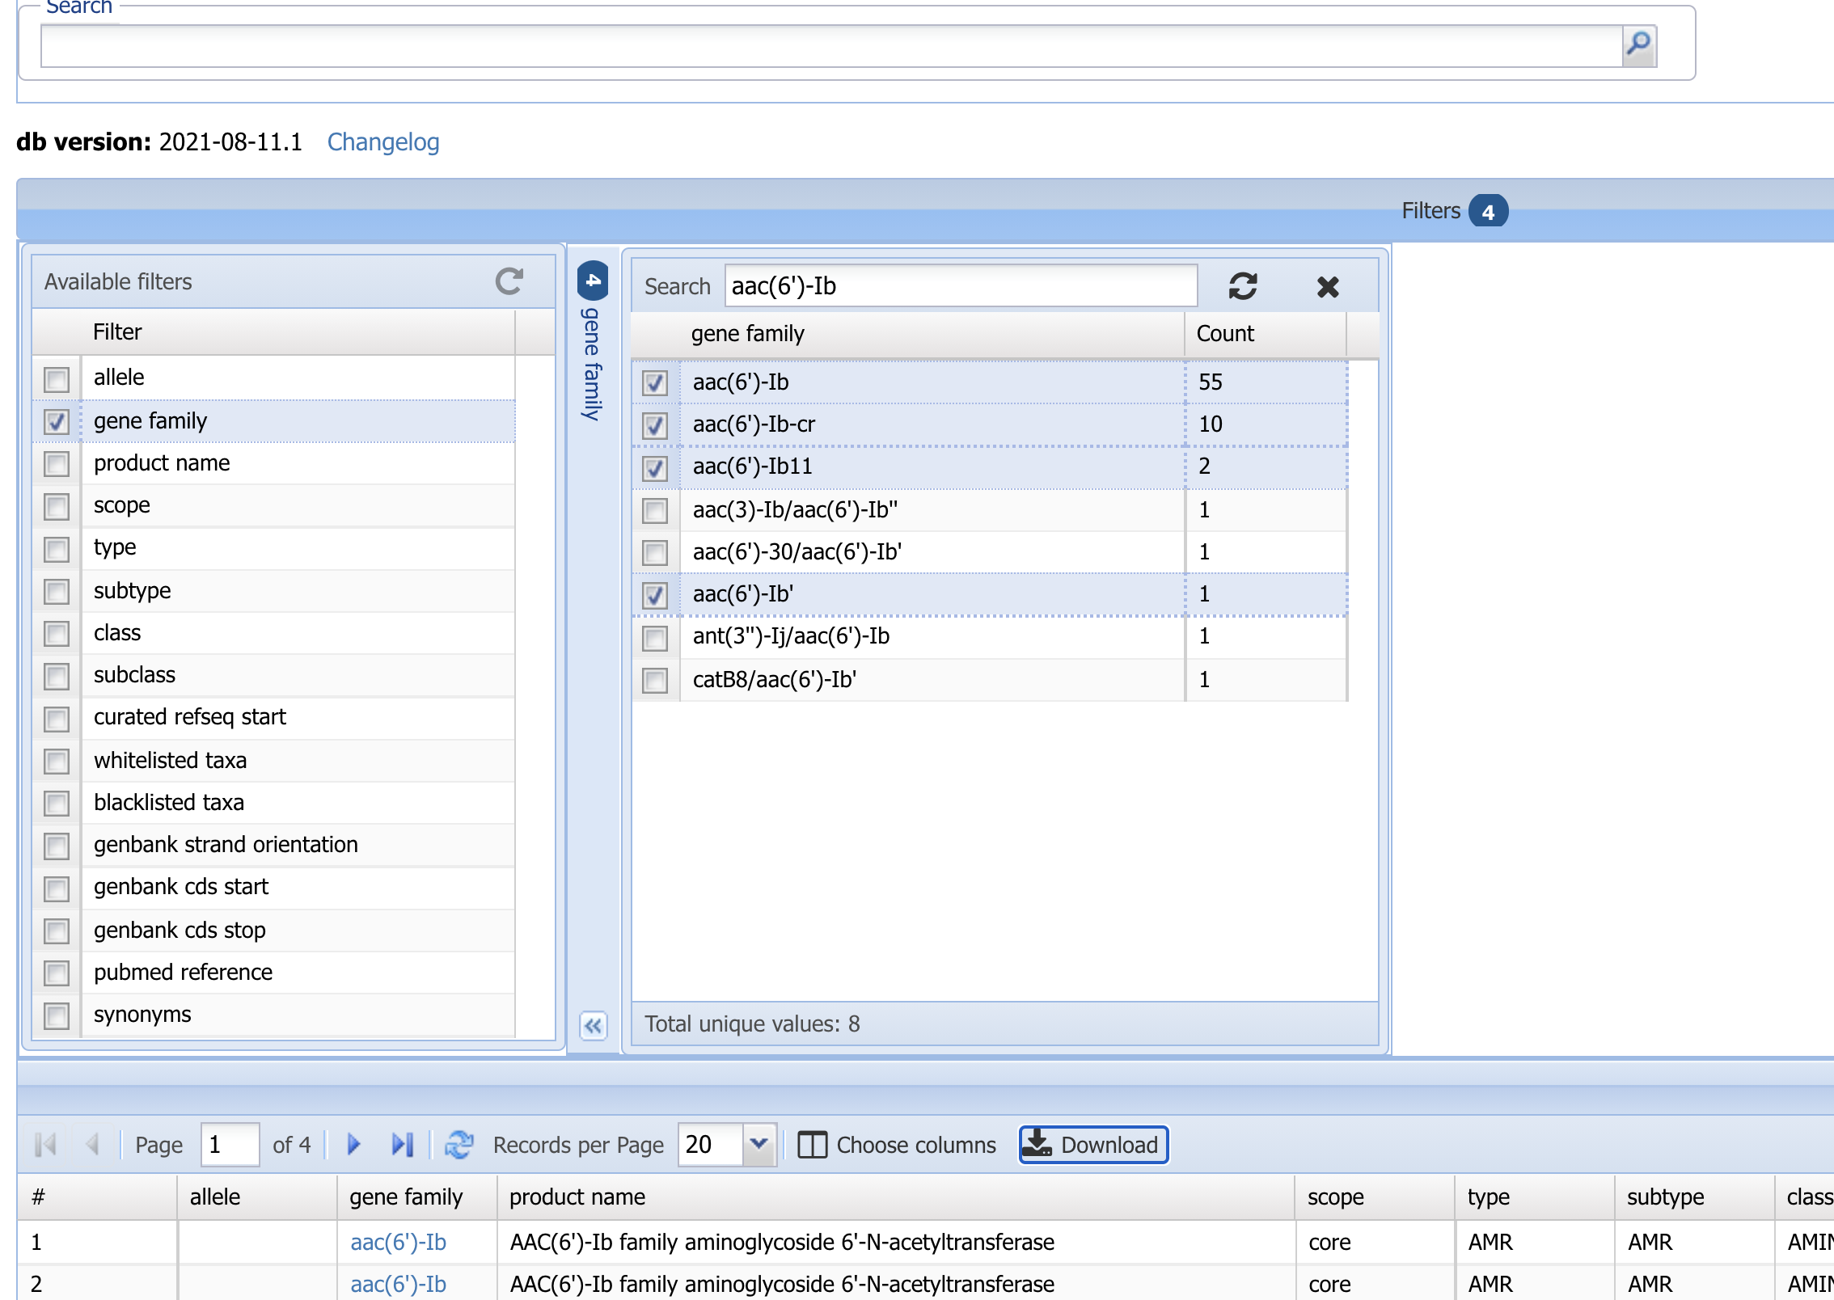
6. Select Download to download table

Slide 7
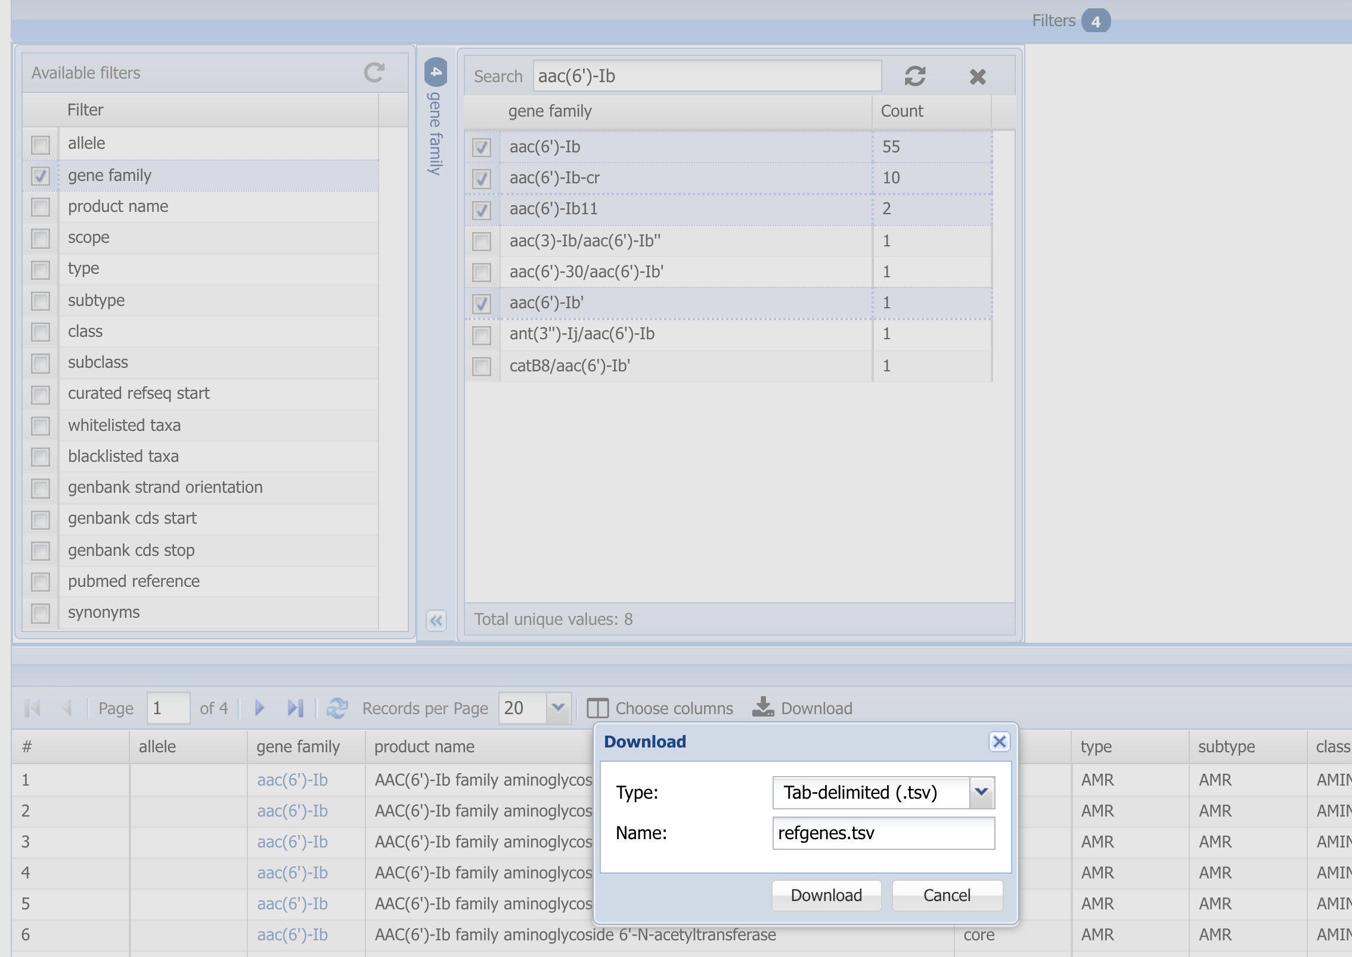
7. Click Download to download table

Slide 8
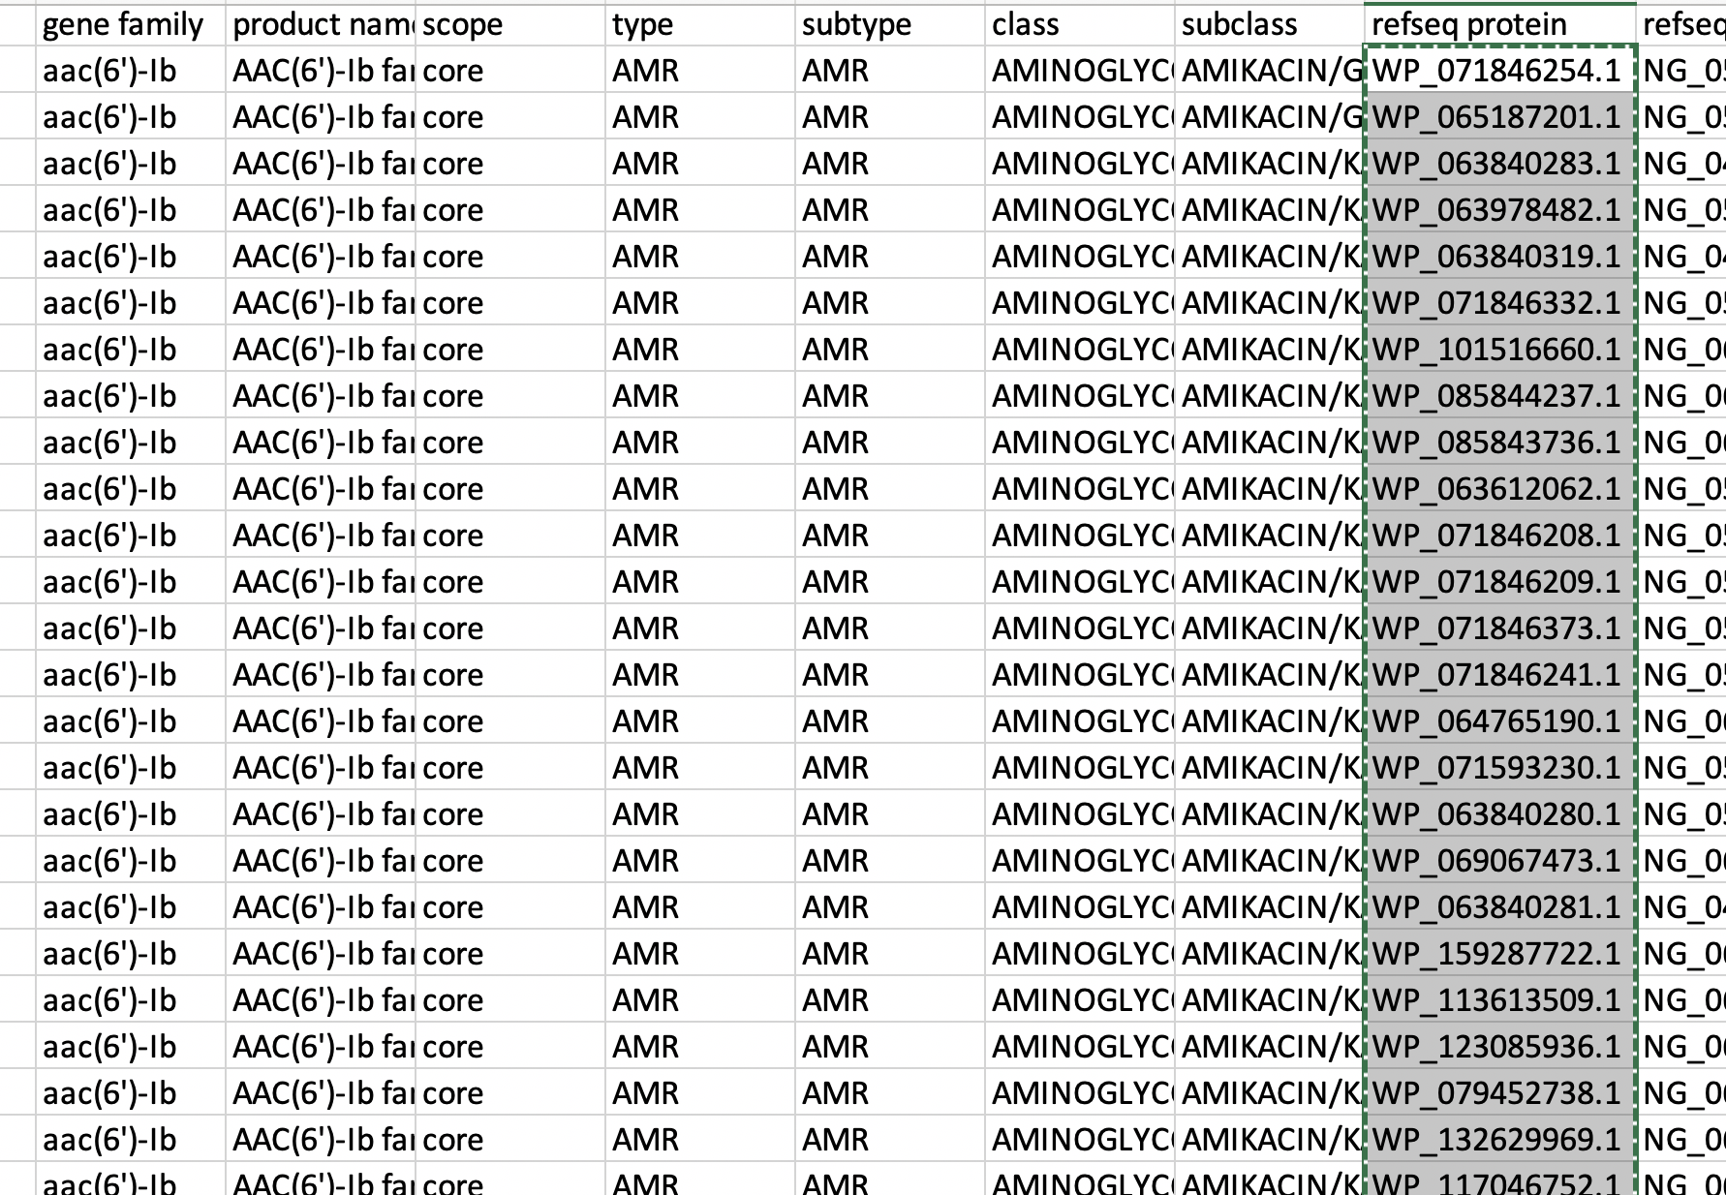
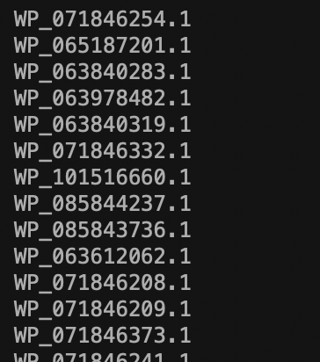
8. Place the protein accessions into a single column text file, with one accession per row. Then go to Batch Entrez

Slide 9
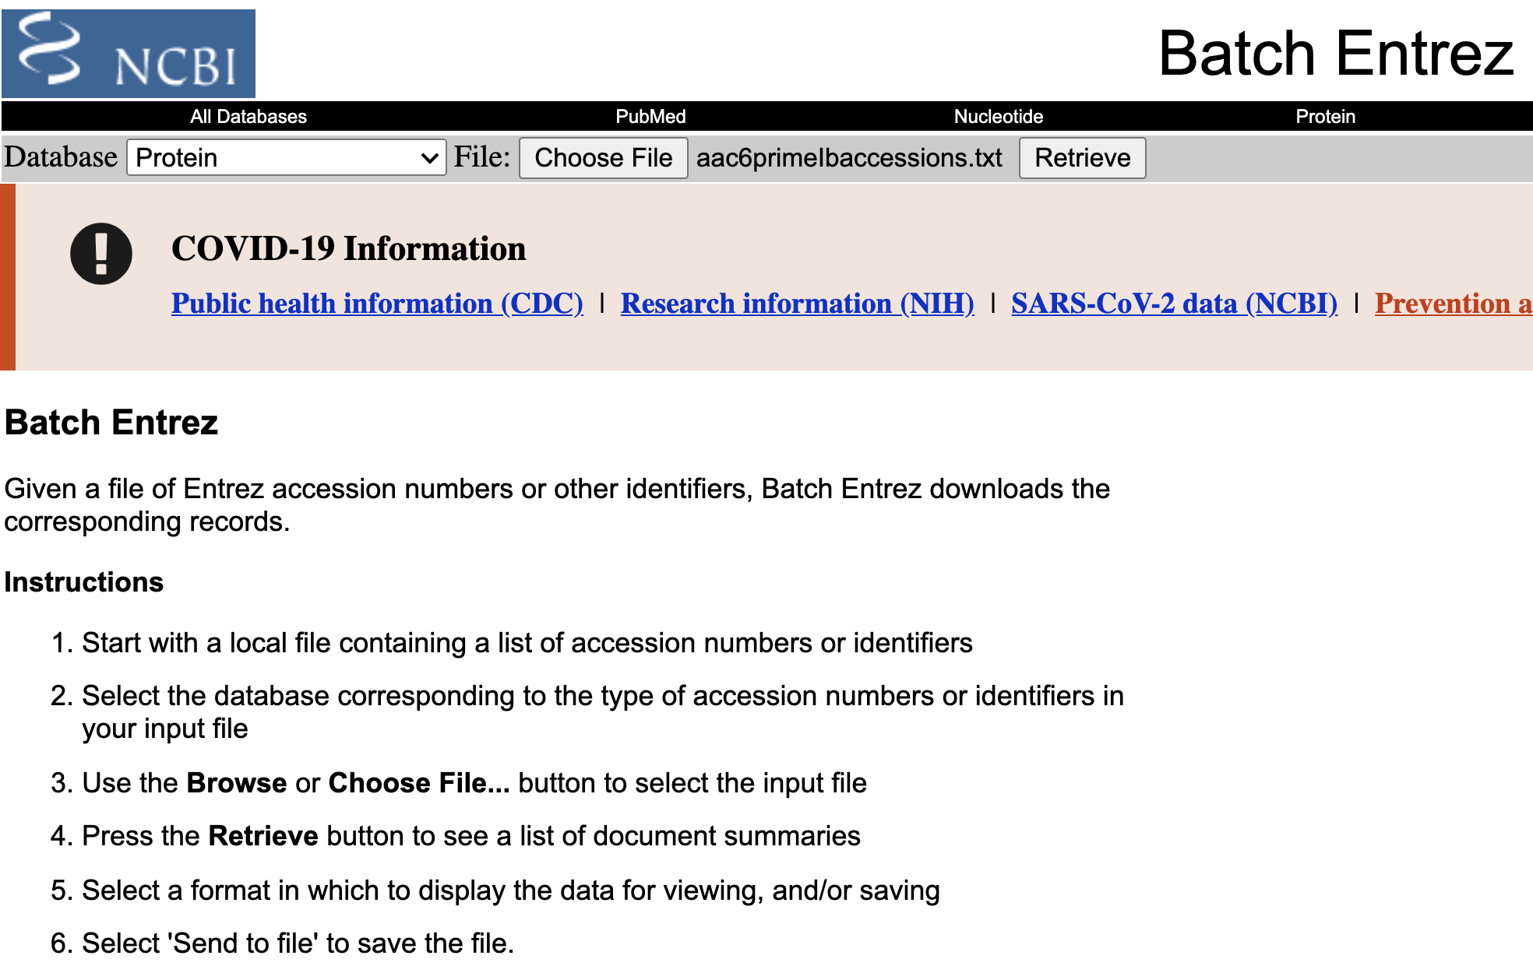
9. Select the Protein database.
10. Upload the text file containing the accession.
11. Select Retrieve.

Slide 10
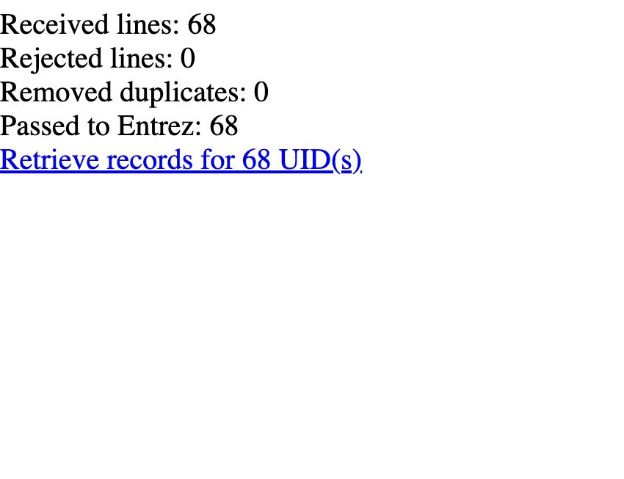
12. Select Retrieve.

Slide 11
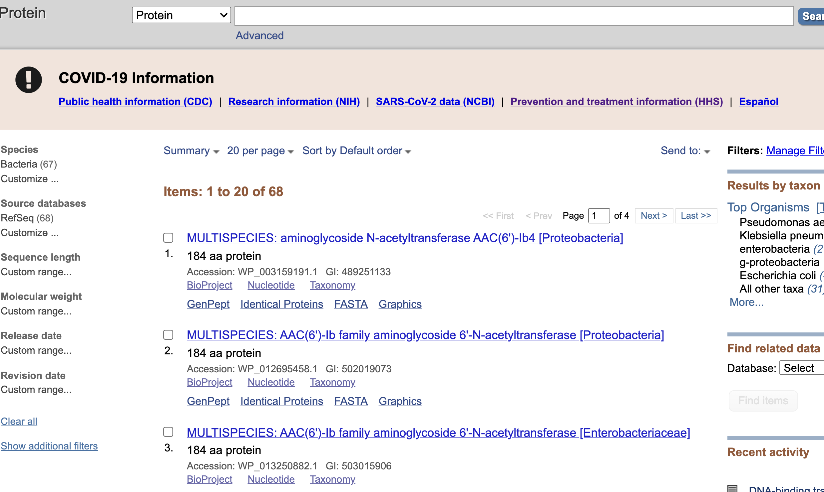
15. Select the “Send to:” pulldown menu.

Slide 12
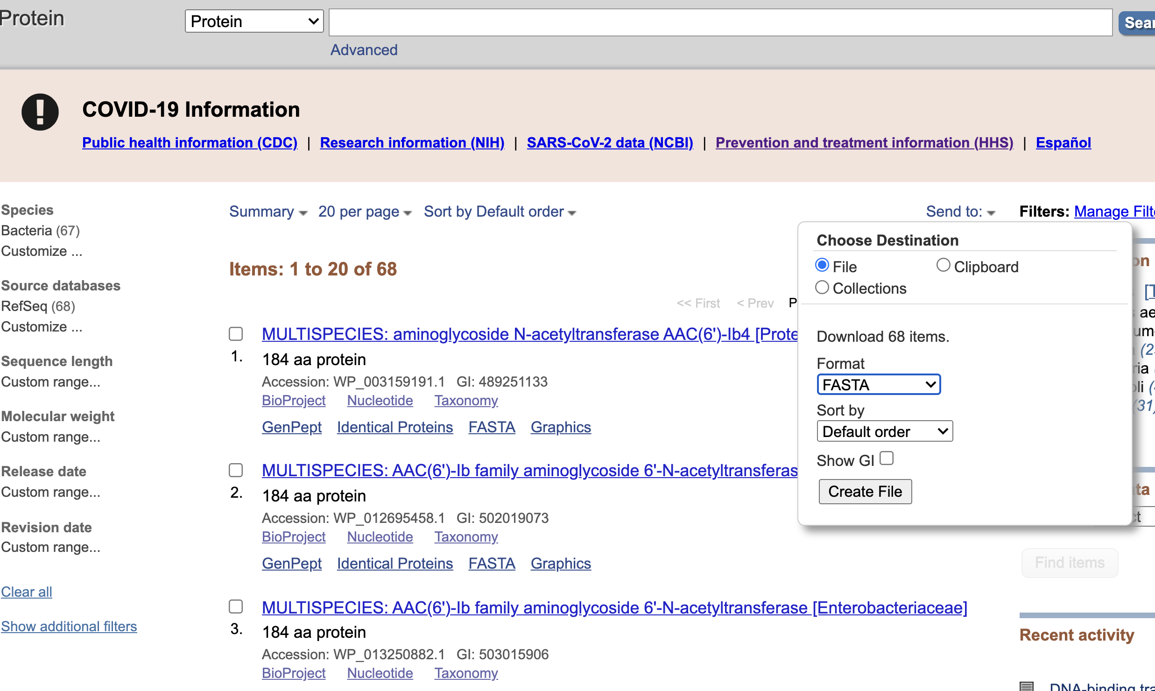
14. Select FASTA.
15. Select Create File.

Slide 13
More information
For full help documentation of the Reference Gene Catalog see: https://www.ncbi.nlm.nih.gov/pathogens/pathogens_help/#reference-gene-catalog
For details about filters see:
https://www.ncbi.nlm.nih.gov/pathogens/pathogens_help/#refgene-filters
For details about the table downloads see:
https://www.ncbi.nlm.nih.gov/pathogens/pathogens_help/#refgene-access-download
Questions and further help: email pd-help@ncbi.nlm.nih.gov

