Slide 1
How To: Download the nucleotide sequence of all MCR-1 alleles
NCBI Pathogen Detection https://www.ncbi.nlm.nih.gov/pathogens

Slide 2
How do I download the nucleotide sequence of all MCR-1 alleles?
Use MicroBIGG-E
Use filters or search to select Element symbol “mcr-1”
Download nucleotide fasta file

Slide 3
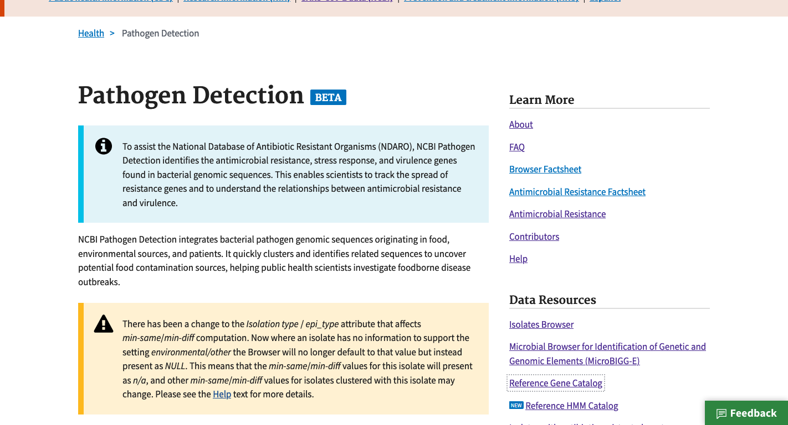
https://www.ncbi.nlm.nih.gov/pathogens
1. Click MicroBIGG-E

Slide 4
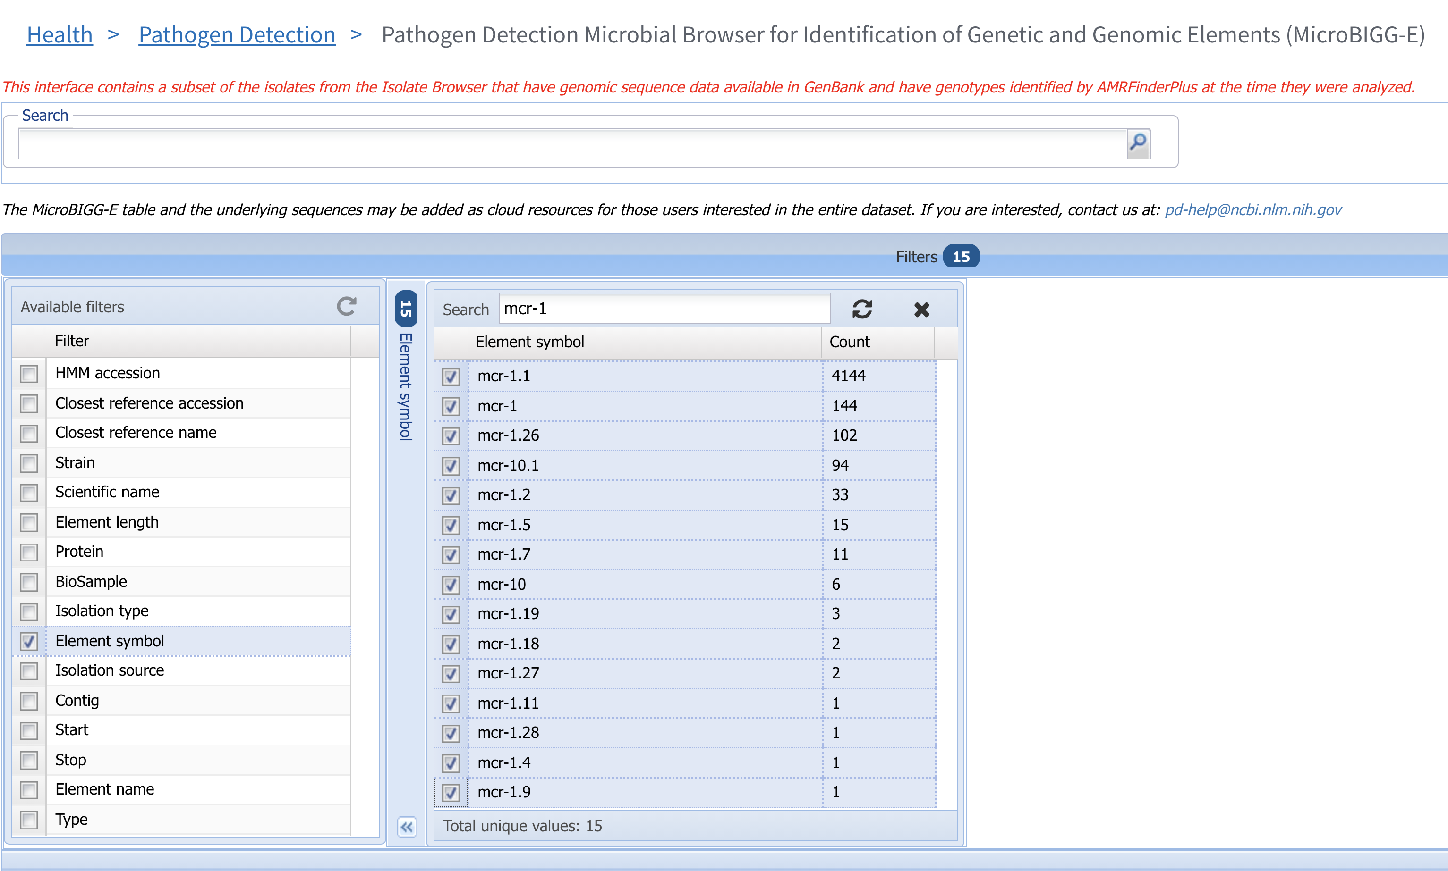
2. Click Filters bar to show filters
4. Select MCR alleles of interest
3. Click Element symbol to show organism group and isolation type filters

Slide 5
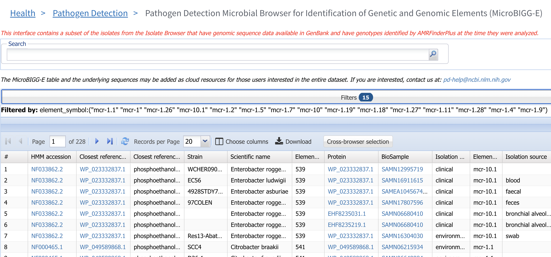
5. Note search syntax

Slide 6
6. Click Download

Slide 7
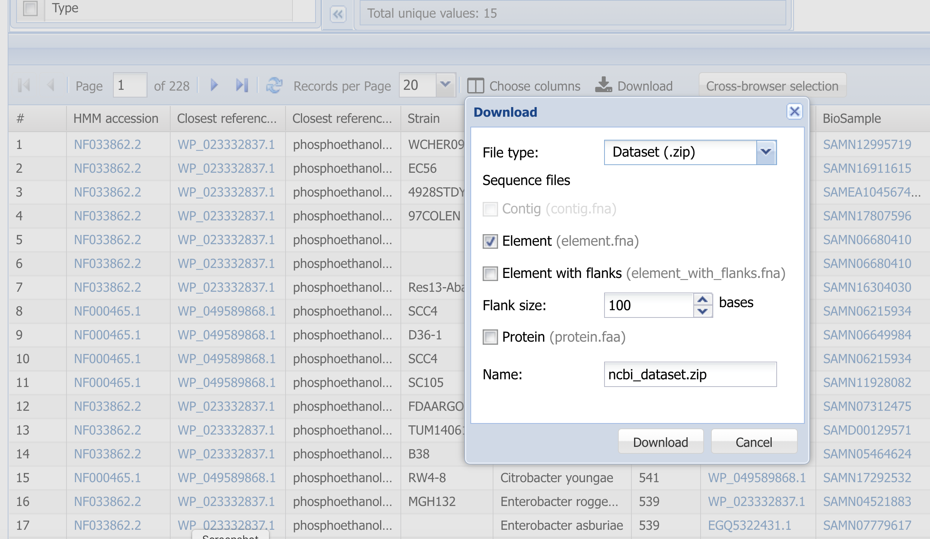
7. Select Element (element.fa) for nucleotide sequence of the mcr gene
8. Click Download

Slide 8
More information
For full help documentation of the Reference Gene Catalog see: https://www.ncbi.nlm.nih.gov/pathogens/pathogens_help/#reference-gene-catalog
For details about filters see:
https://www.ncbi.nlm.nih.gov/pathogens/pathogens_help/#refgene-filters
For details about the table downloads see:
https://www.ncbi.nlm.nih.gov/pathogens/pathogens_help/#refgene-access-download
Questions and further help: email pd-help@ncbi.nlm.nih.gov

